Slide 1
Internship Project on Phishing Detection
PRIYANKA RAMCHANDRA PARAB
Code B - Data Science Integrated Internship

Slide 3
Introduction
Project Overview: Explain the objective of phishing detection. Importance: How phishing attacks impact cybersecurity.
internship Document
Introduction: During my internship, I had the opportunity to work on a Phishing Detection project using machine learning. This experience allowed me to apply my technical skills to a real-world cybersecurity problem while also developing my problem-solving and collaboration abilities.
Project Experience: The project involved multiple stages, including data preprocessing, model training, evaluation, and deployment. I worked extensively with a phishing dataset, exploring feature engineering techniques and training a Random Forest model to classify phishing and legitimate URLs. The evaluation included confusion matrices and ROC curves to assess model perfor
mance.
Challenges Faced:
Data Quality Issues: Some data points required extensive preprocessing and cleaning to ensure model accuracy.
Feature Engineering: Selecting the most relevant features for better performance was a crucial step.
Model Optimization: Fine-tuning hyperparameters for the best results required multiple iterations.

Slide 4
Key Learnings:
Improved my data preprocessing and feature selection skills.
Gained hands-on experience with machine learning models and performance evaluation metrics.
Understood the importance of business impact in machine learning solutions.
Learned how to interpret and visualize model results effectively using Python and PowerPoint.
Professional Growth: This internship strengthened my ability to work on real-world data science problems, collaborate with teams, and effectively present findings through structured reports and presentations. It also enhanced my ability to adapt to challenges and refine solutions based on feedback.
Incorporating Feedback: Throughout the project, which helped me improve the clarity of my presentation, optimize my model, and refine visualizations. I revised my slides to enhance readability and included additional insights for a more impactful presentation.
Conclusion: This internship has been an enriching experience, allowing me to bridge the gap between theoretical knowledge and real-world applications. The skills I have gained will be instrumental in my future endeavors in data science and cybersecurity.
Importance: How phishing attacks impact cybersecurity.
Goal: Develop an ML model to detect phishing websites

Slide 5
Challenges Faced:
Data Quality Issues:
The dataset contained missing and inconsistent values, requiring extensive data cleaning and preprocessing.
Some features needed transformation to improve model performance.
Algorithm Selection:
Choosing the right machine learning model was challenging due to the trade-off between accuracy and computational efficiency.
Experimented with models like Logistic Regression, Decision Trees, and Random Forest, finally selecting Random Forest for its better performance.
Feature Engineering:
Identifying the most relevant URL-based features that contribute to phishing detection was crucial.
Tried different feature selection techniques to remove irrelevant variables and improve accuracy.
Model Evaluation:
Evaluating model performance using confusion matrices, ROC curves, and accuracy scores was necessary to select the best model.
Needed to tune hyperparameters to improve precision and recall.
Deployment Challenges:
Converting the trained model into a deployable format and integrating it with a user-friendly interface posed some difficulties.
Ensuring real-time predictions with minimal latency was a key concern.

Slide 6
Key Learnings:
Technical Skills Acquired:
Data preprocessing: Handling missing values, feature scaling, and encoding categorical variables.
Machine Learning models: Understanding strengths and weaknesses of different classifiers.
Performance tuning: Using hyperparameter tuning (e.g., GridSearchCV) to improve model efficiency.
Model Evaluation: Interpreting confusion matrices, precision-recall curves, and ROC-AUC scores.
Lessons from Overcoming Challenges:
Importance of feature selection in improving model accuracy.
Need for data preprocessing to ensure a robust dataset.
Balancing accuracy and performance when selecting an ML model.
Significance of user-friendly deployment for real-world application.

Slide 7
Project Workflow
Lifecycle of the Project:
- Problem Definition
- Data Preprocessing
- Model Training
- Model Evaluation
- Deployment
Visual Representation:
Flowchart showing each step.

Slide 8
Project Lifecycle: Phishing Detection using Machine Learning
Problem Definition
Understanding the impact of phishing attacks on cybersecurity.
Defining the goal: Develop an ML model to detect phishing websites.
Identifying key features that differentiate phishing and legitimate websites.
Data Preprocessing
Collected and cleaned the phishing dataset.
Handled missing values and removed redundant features.
Feature engineering: Extracting meaningful patterns from URLs, domain names, and website structures.
Data normalization and transformation for better model performance.
Model Training
Split the dataset into training and testing sets.
Selected multiple classifiers (e.g., Decision Trees, Random Forest, SVM) and tuned hyperparameters.
Applied techniques like cross-validation to improve generalization.
Model Evaluation
Assessed performance using metrics like accuracy, precision, recall, and F1-score.
Visualized results using confusion matrices and ROC curves.
Compared models to identify the best-performing approach.
Deployment
Integrated the model into a web-based detection system.
Optimized response time to classify phishing attempts in real time.
Ensured continuous monitoring and updates for model improvement.

Slide 9
Data Preprocessing
Dataset Details: Source and size of data.
Handling Missing Values: Techniques used.
Feature Engineering: Extracted features from URLs.

Slide 10
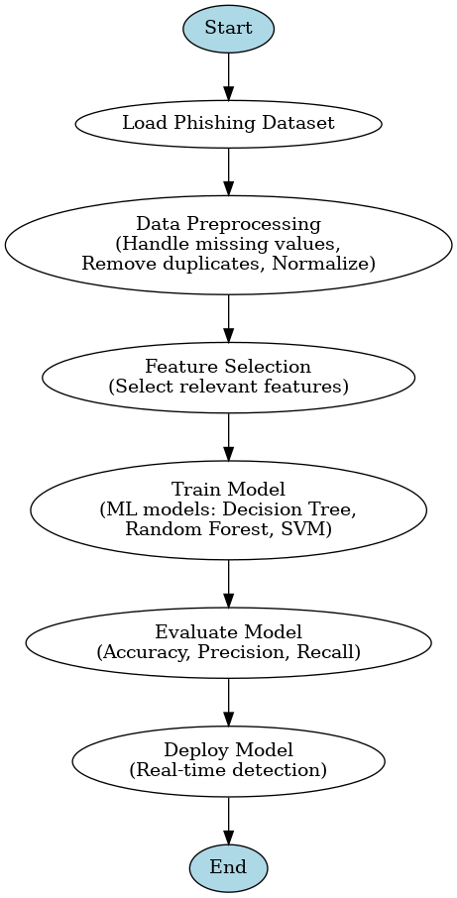

Slide 11
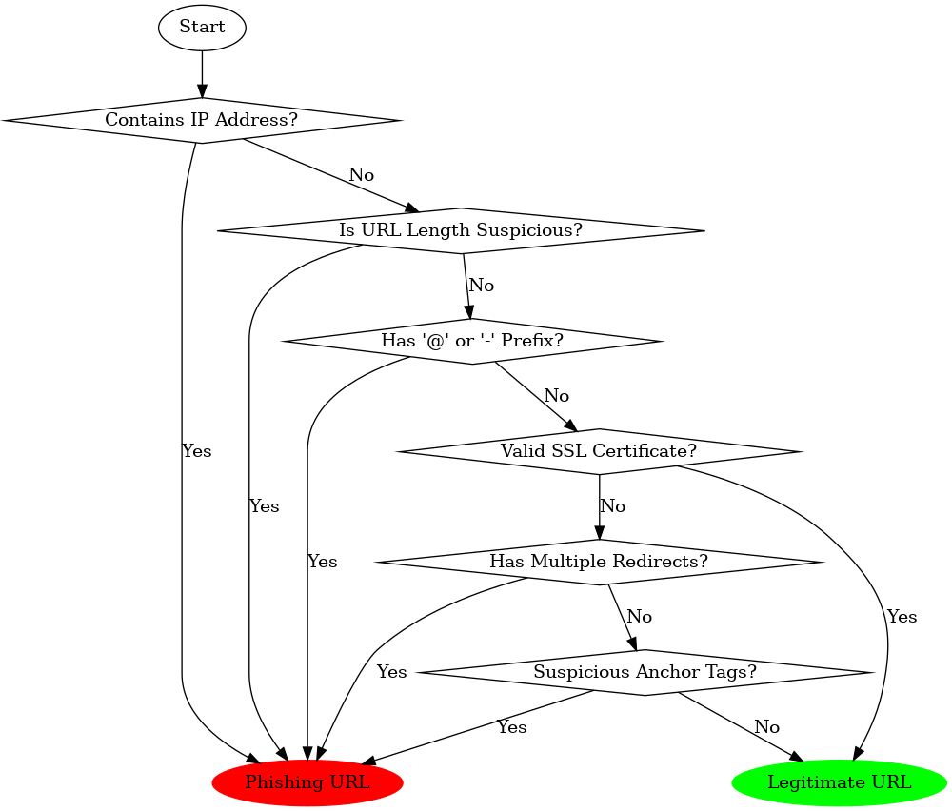

Slide 12
Model Training & Evaluation
Model Used: Random Forest, Decision Trees, etc.
Performance Metrics: Accuracy, Precision, Recall, F1-score.
ROC Curve and Confusion Matrix Visualization.

Slide 13
Model Interpretation (SHAP & LIME)
SHAP Analysis: Feature importance visualization.
LIME Explanation: How predictions are made.
Key Insights: Most influential factors for classification.

Slide 14
Key Insights & Business Impact
Findings from EDA & Model Interpretation.
How the model improves phishing detection.
Business value in cybersecurity.

Slide 15
Challenges & Learnings
Challenges Faced: Data quality issues, model tuning, deployment errors.
Technical Learnings: New skills acquired.
Problem-Solving Strategies.

Slide 16
Internship Reflection
Professional Growth: Team collaboration, handling feedback.
Personal Development: Problem-solving skills.
Real-world ML Application Experience.

Slide 17
Mentor Feedback & Revisions
Summary of Mentor’s Feedback.
Changes Implemented in the Presentation & Model.

Slide 18
Final Presentation Ready for Delivery
Visual Enhancements: Engaging charts and diagrams.
Presenter Notes for Each Slide.

Slide 19
Supporting Materials
Supplementary Documents: Code, dataset, references.
Model & API files.

Slide 20
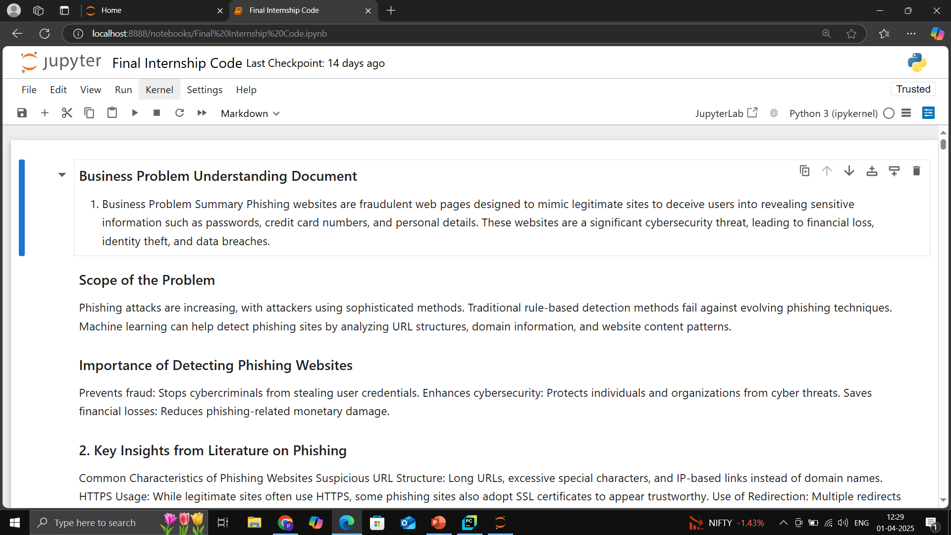

Slide 21
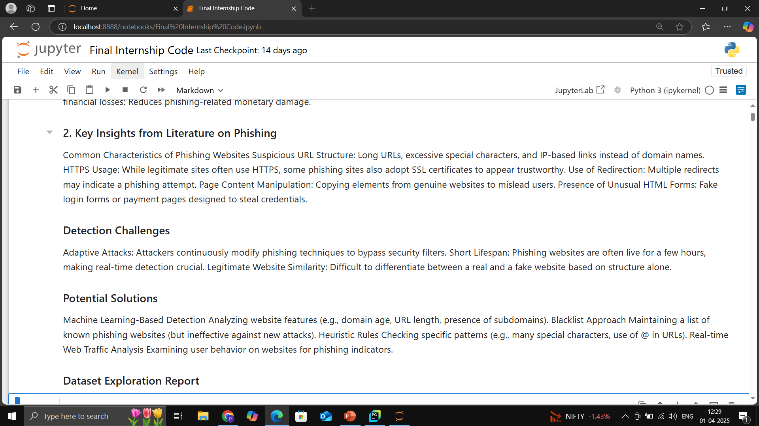

Slide 22
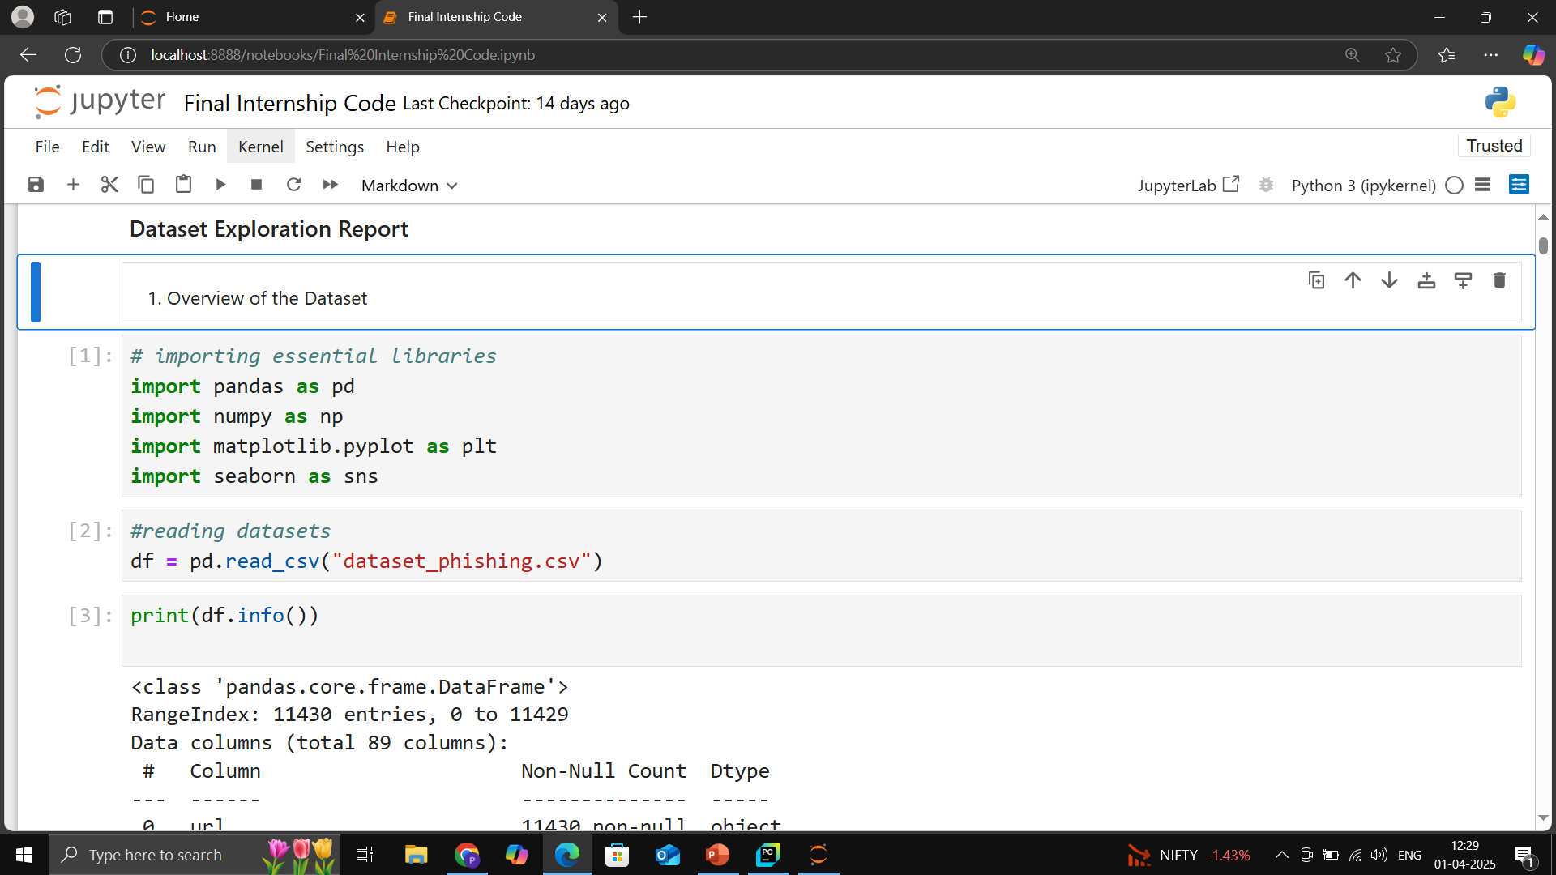

Slide 23
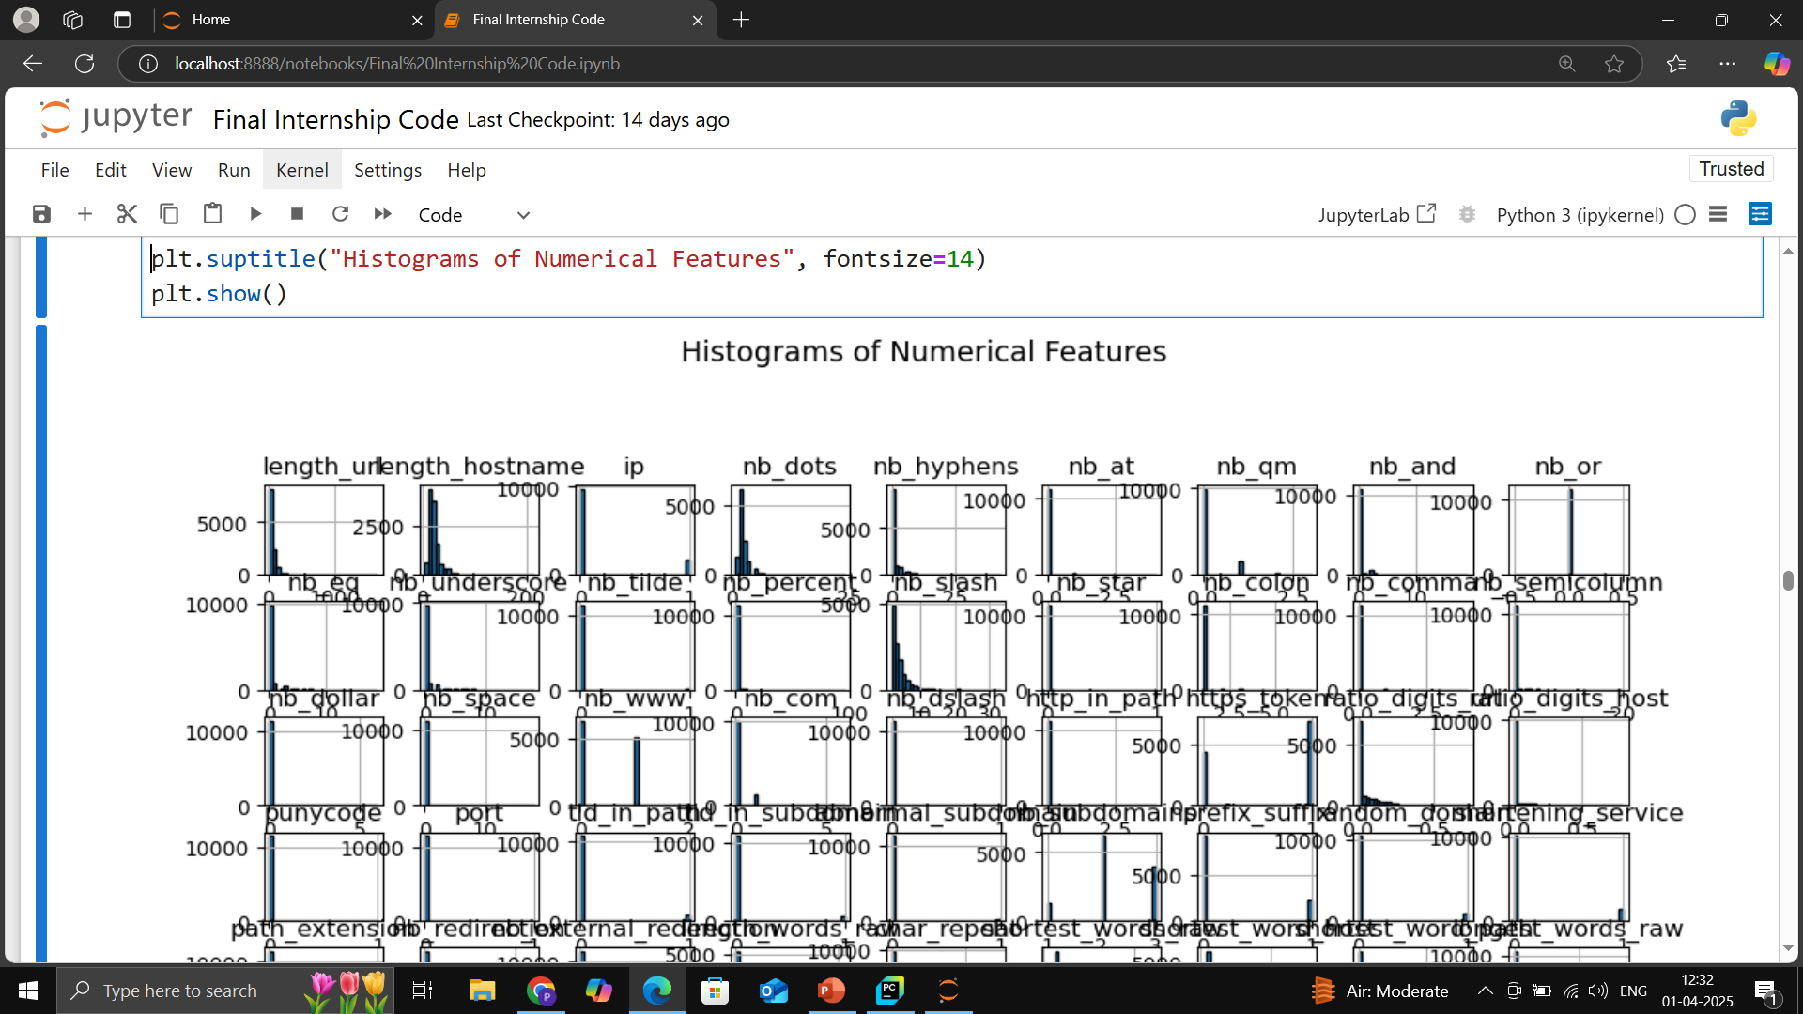

Slide 24
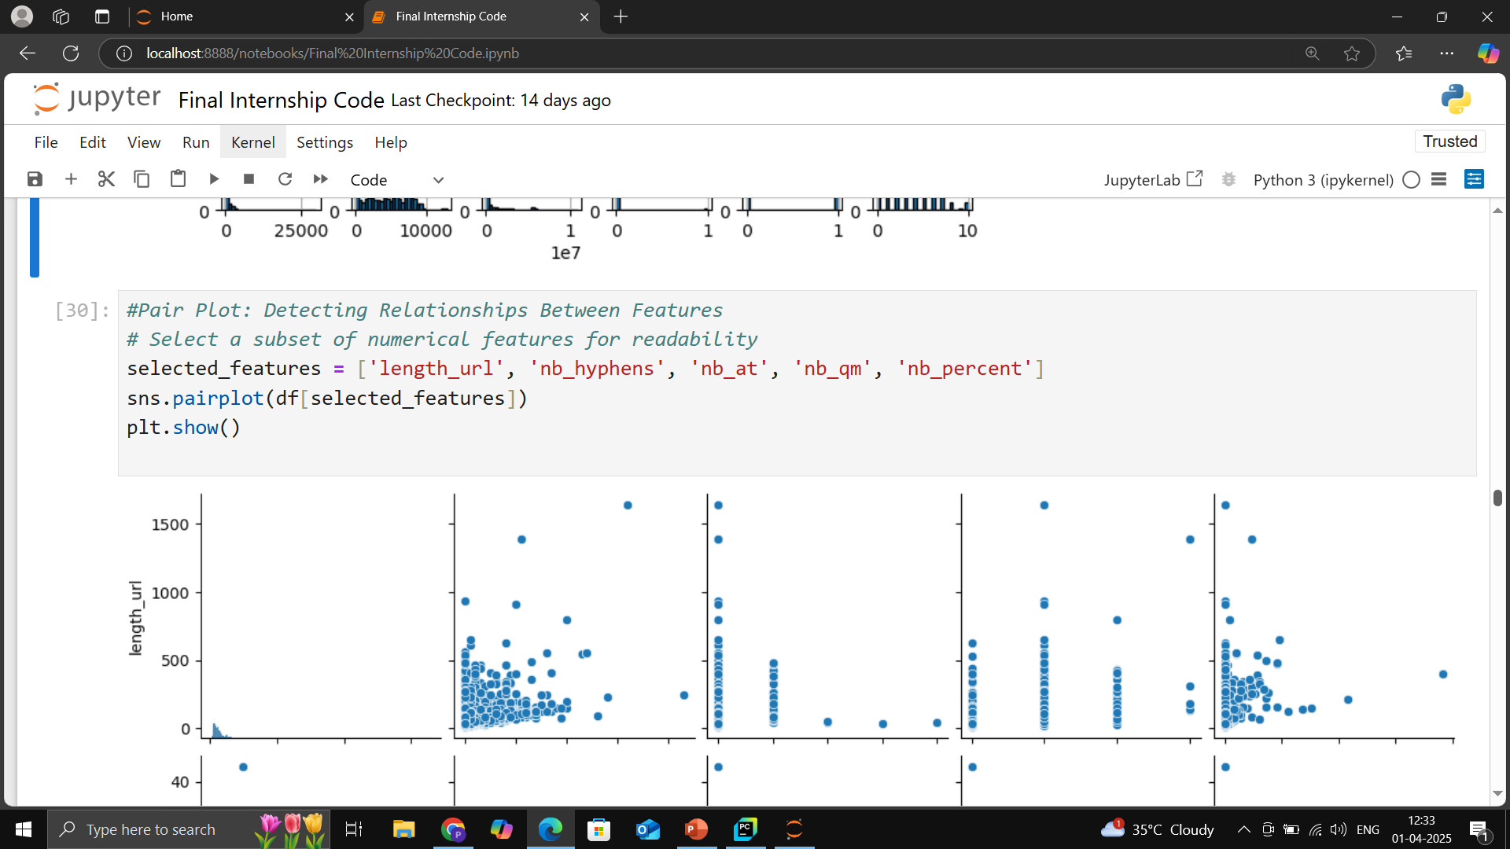

Slide 25
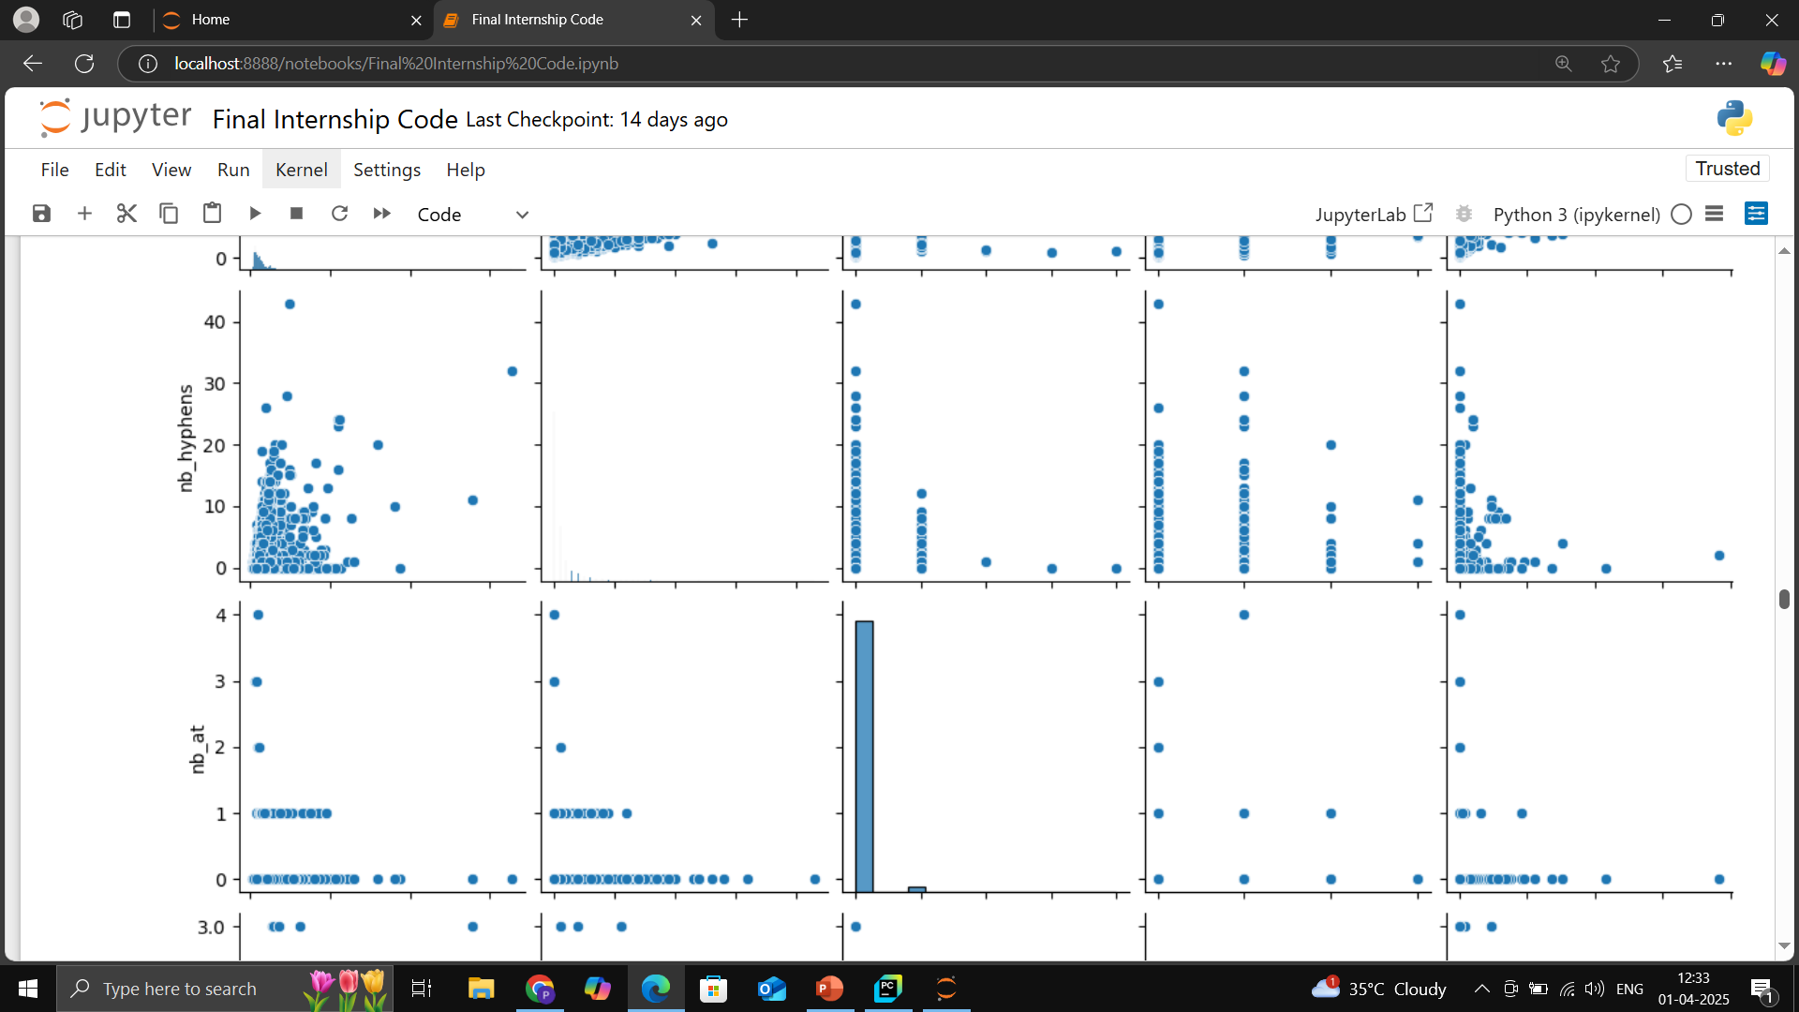

Slide 26
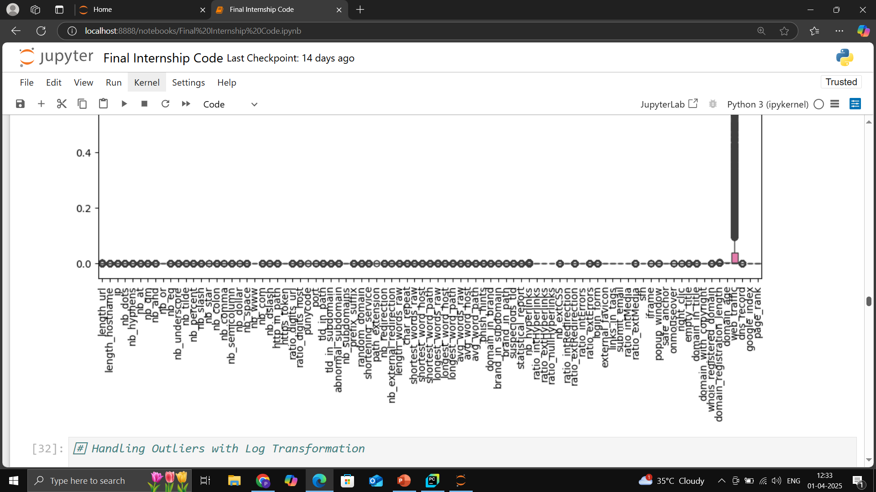
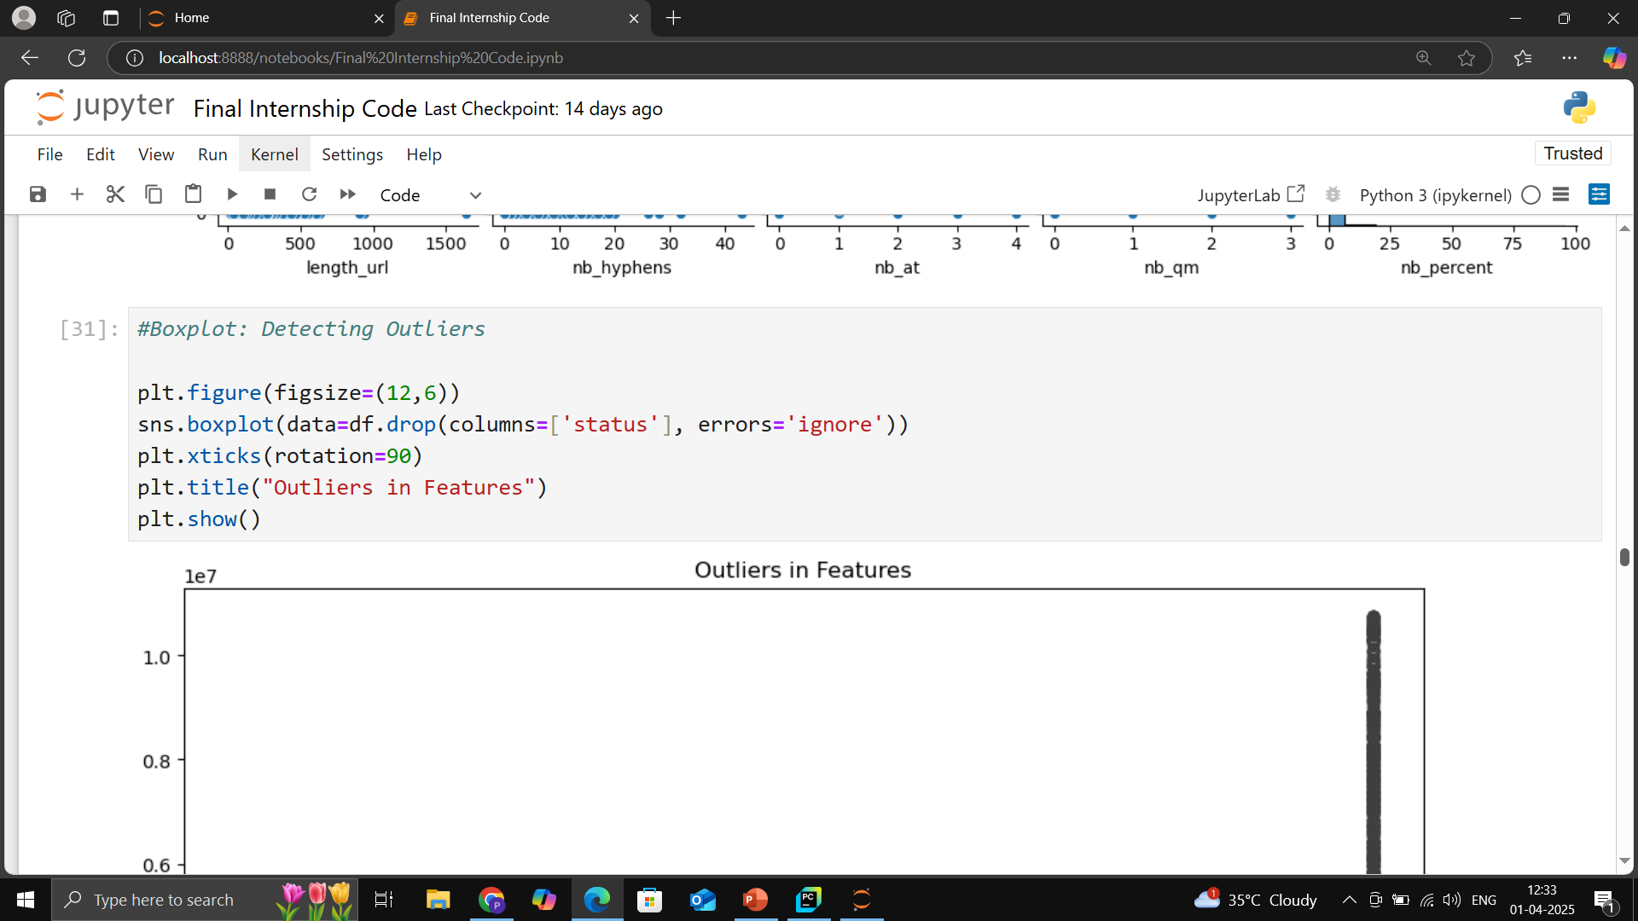

Slide 27
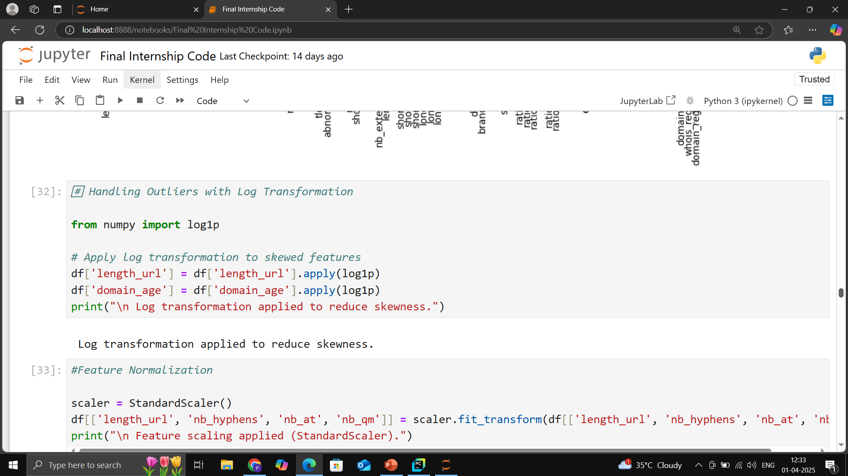

Slide 28
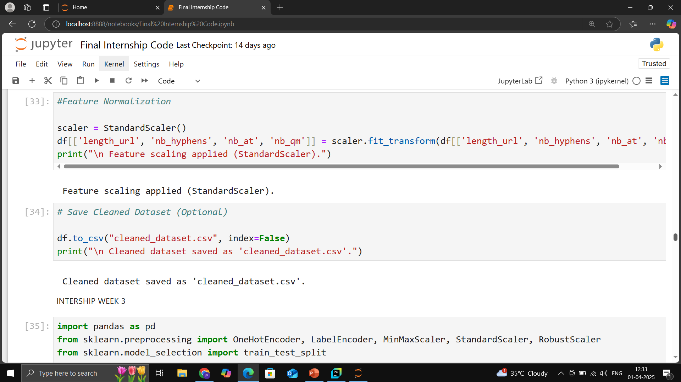

Slide 29
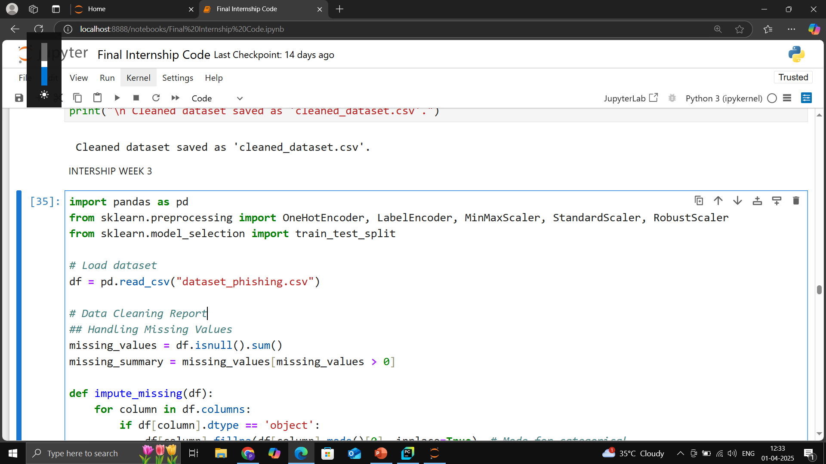

Slide 30
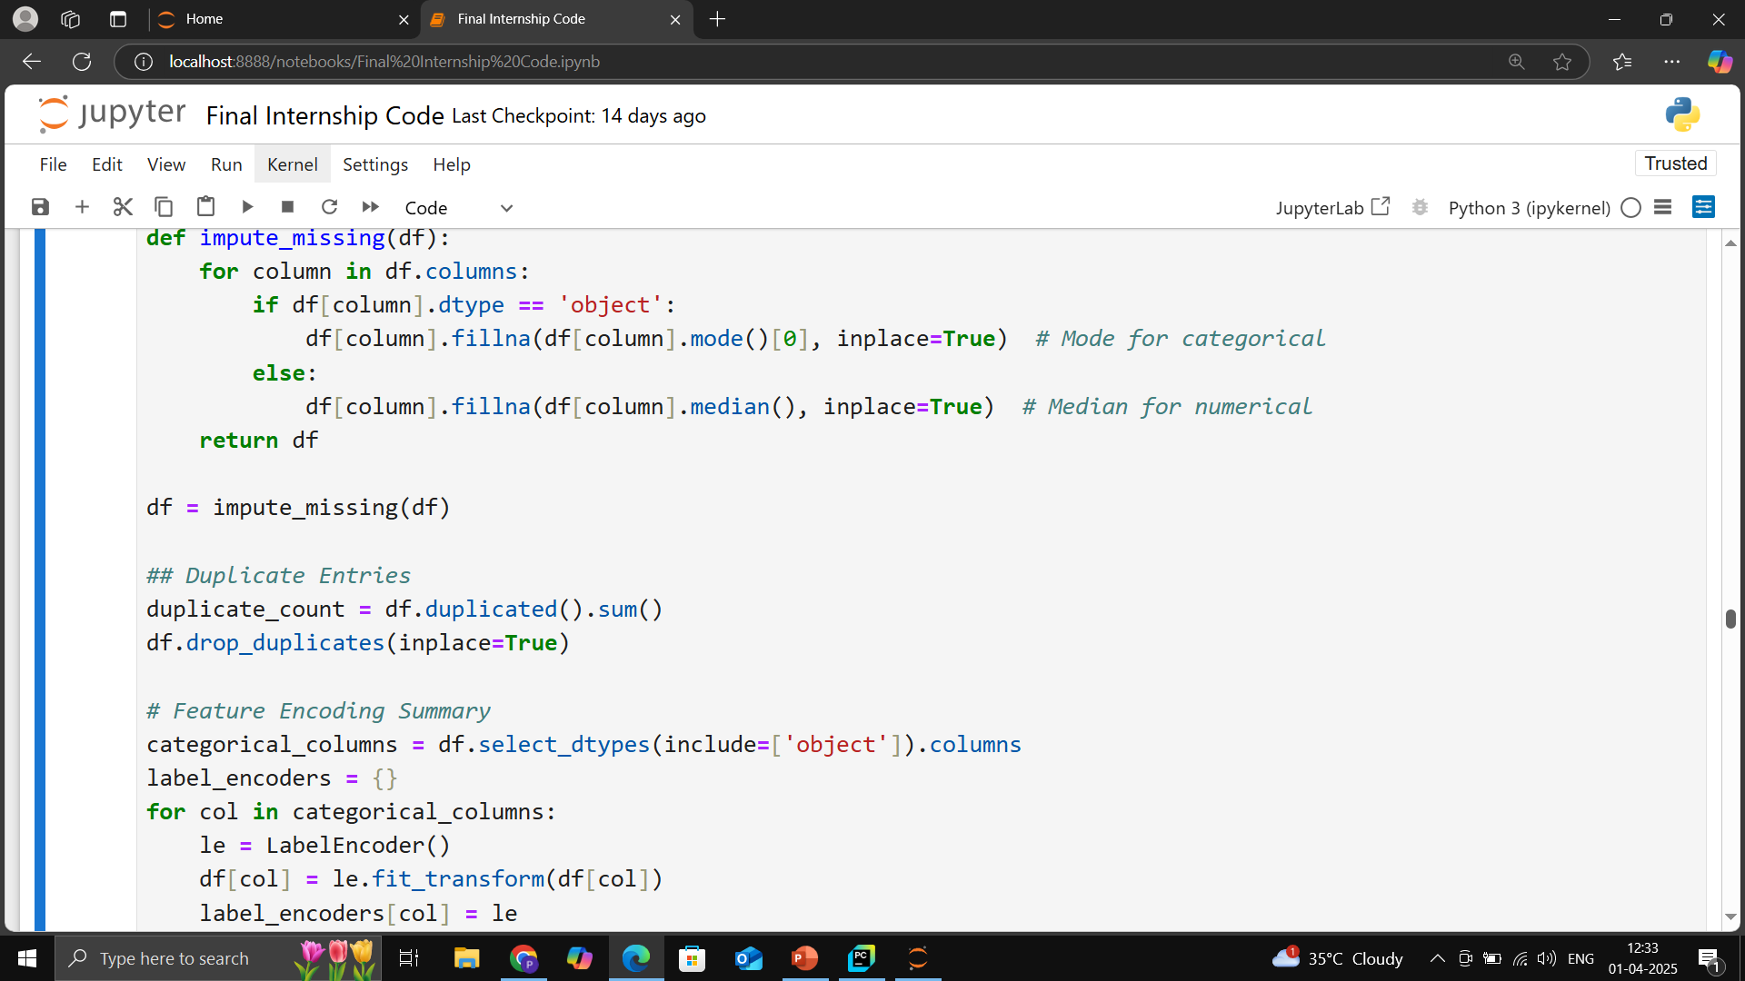

Slide 31
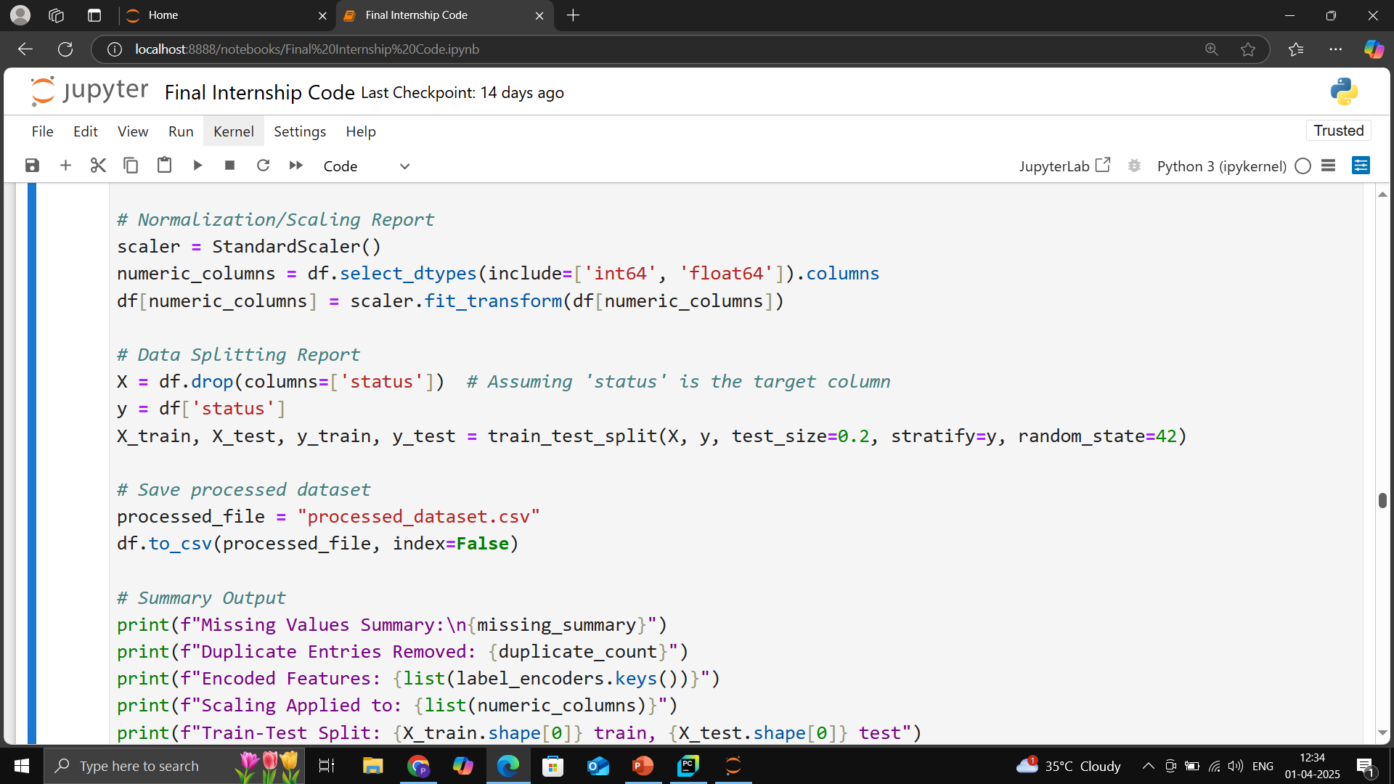

Slide 32
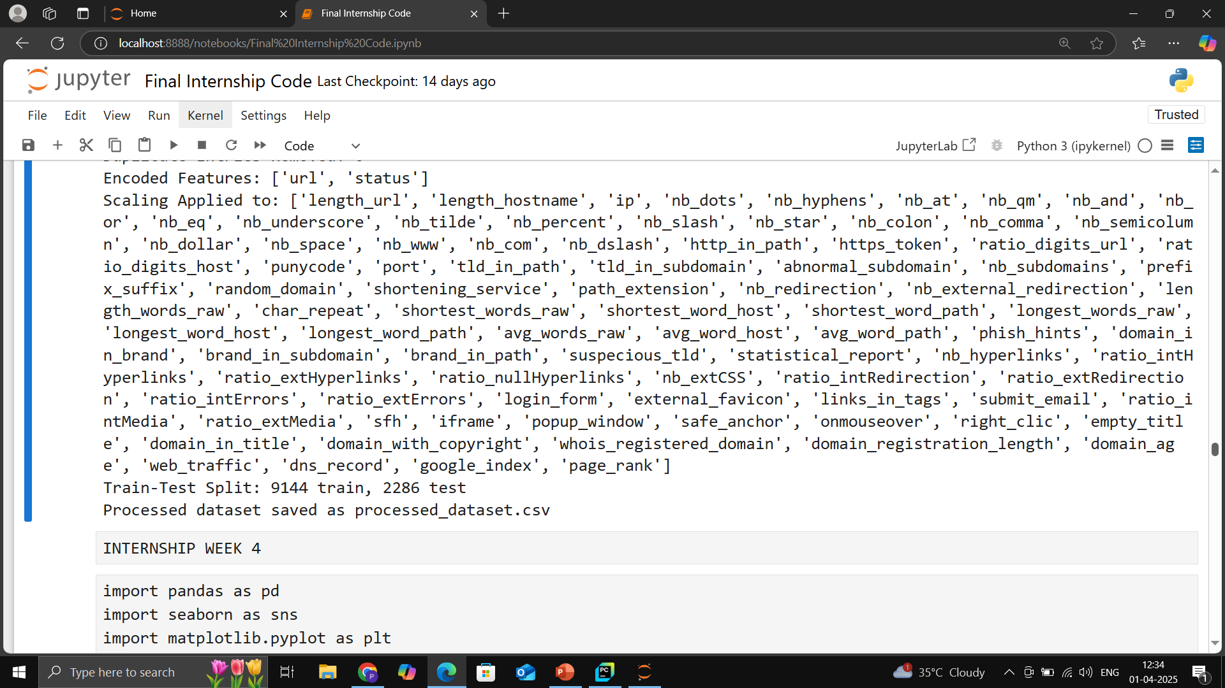

Slide 33
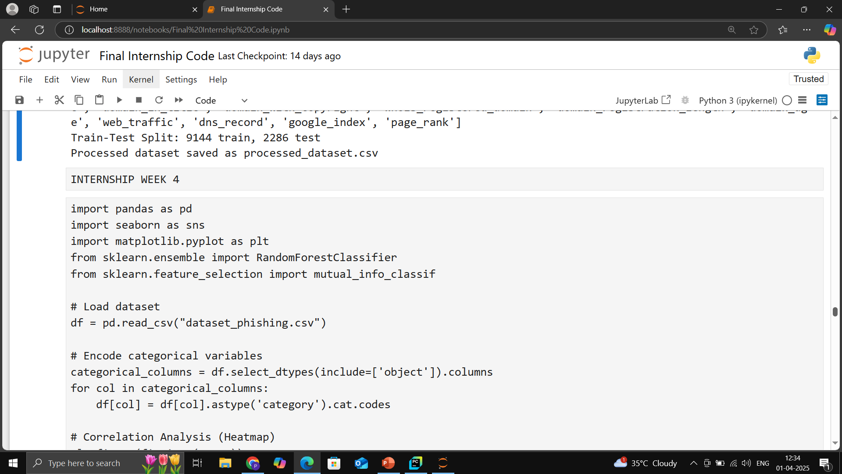

Slide 34
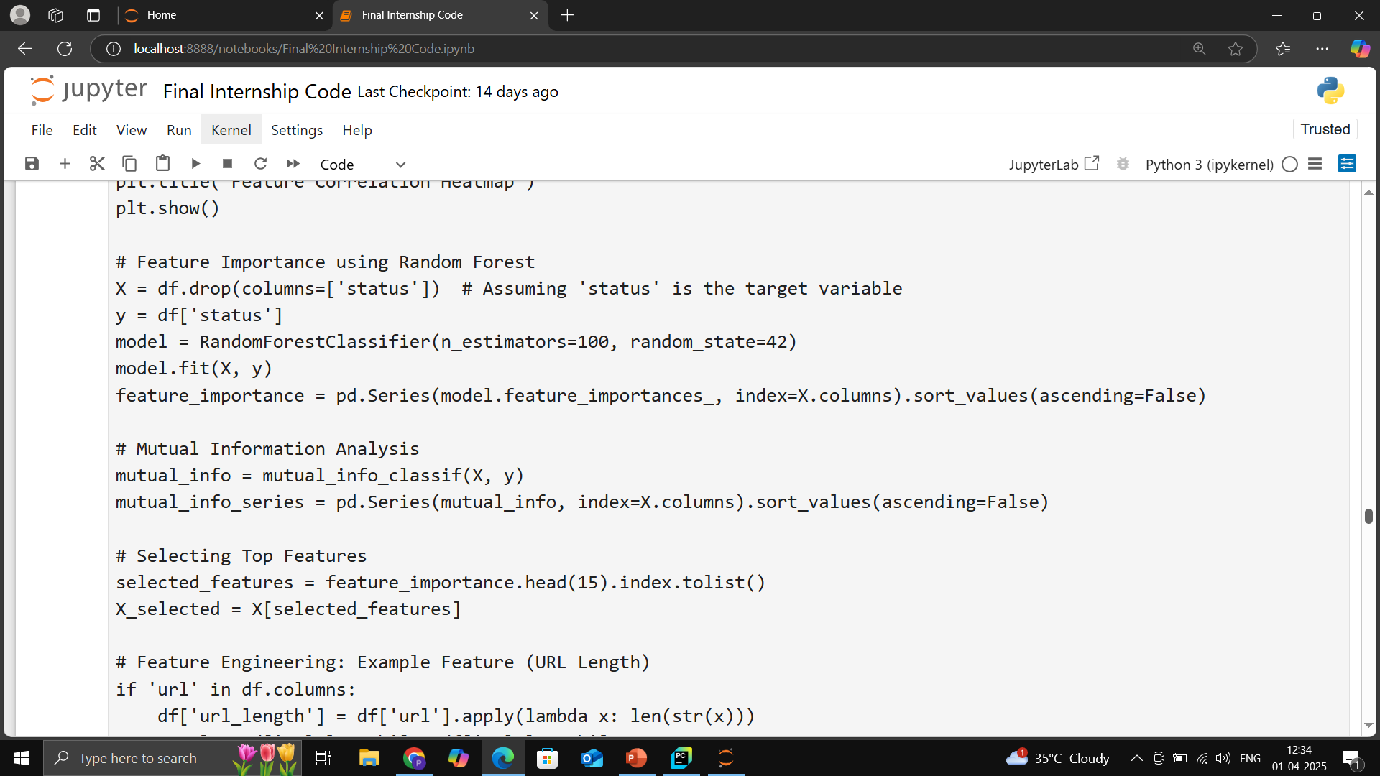

Slide 35
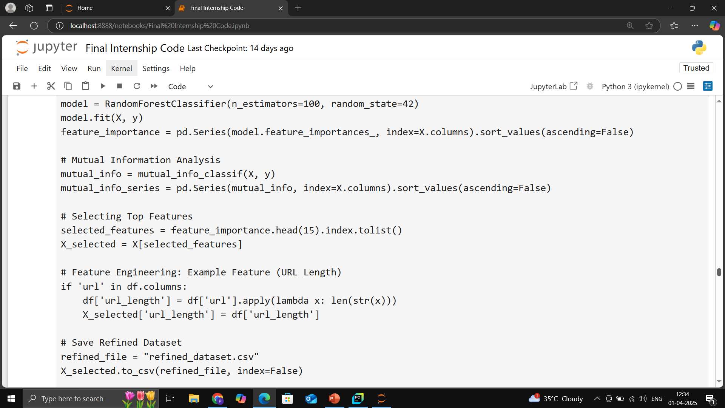

Slide 36


Slide 37
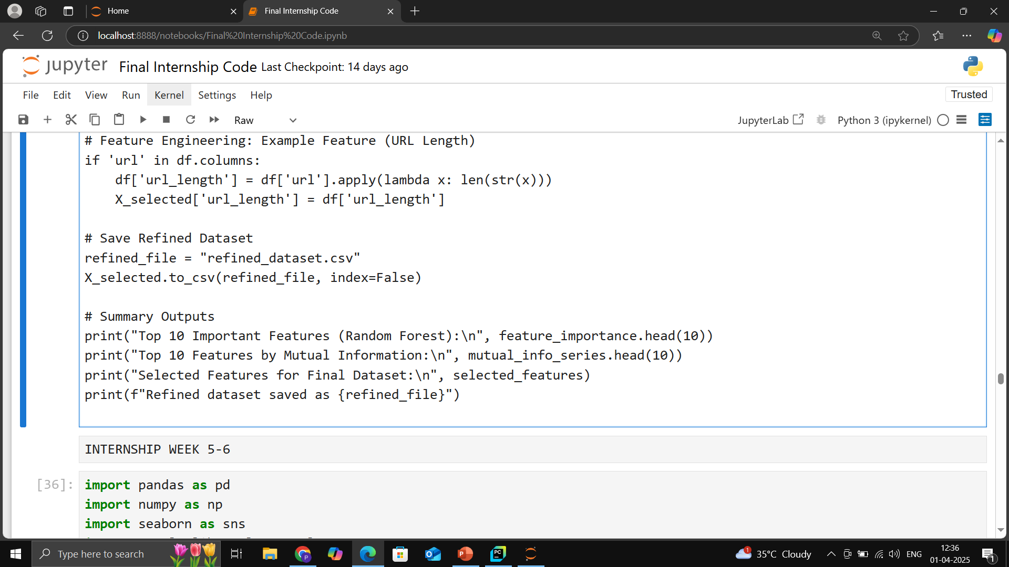

Slide 38
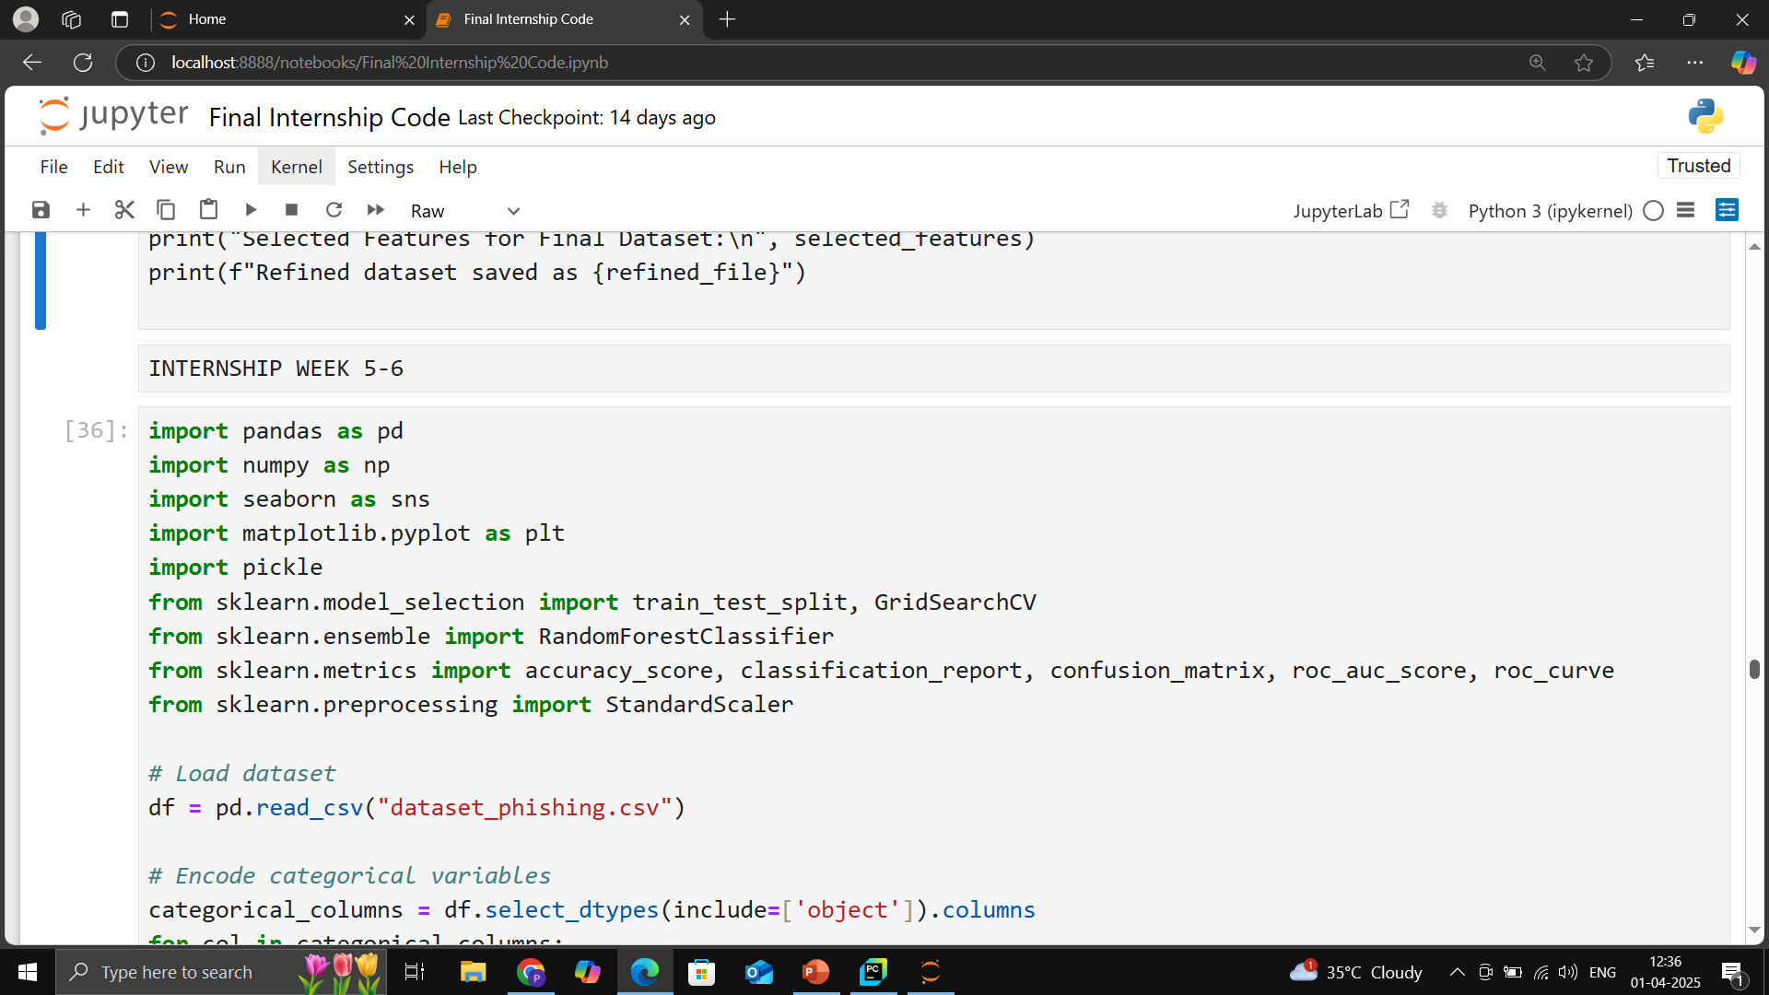

Slide 39
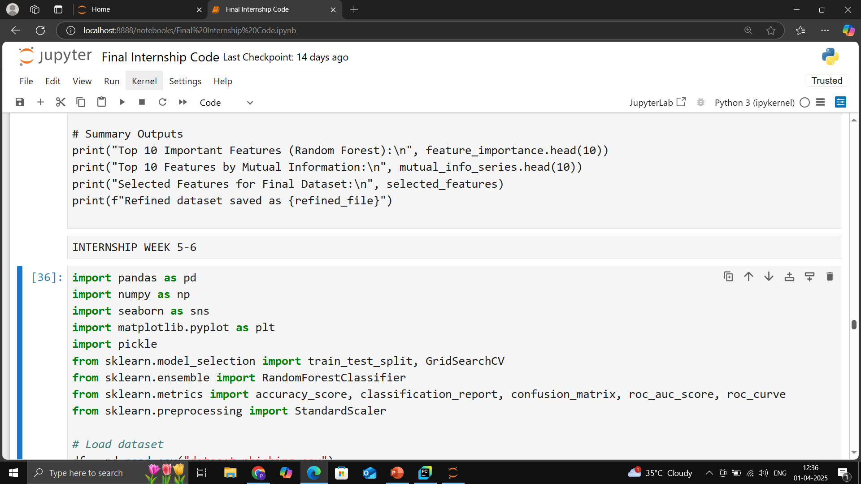

Slide 40
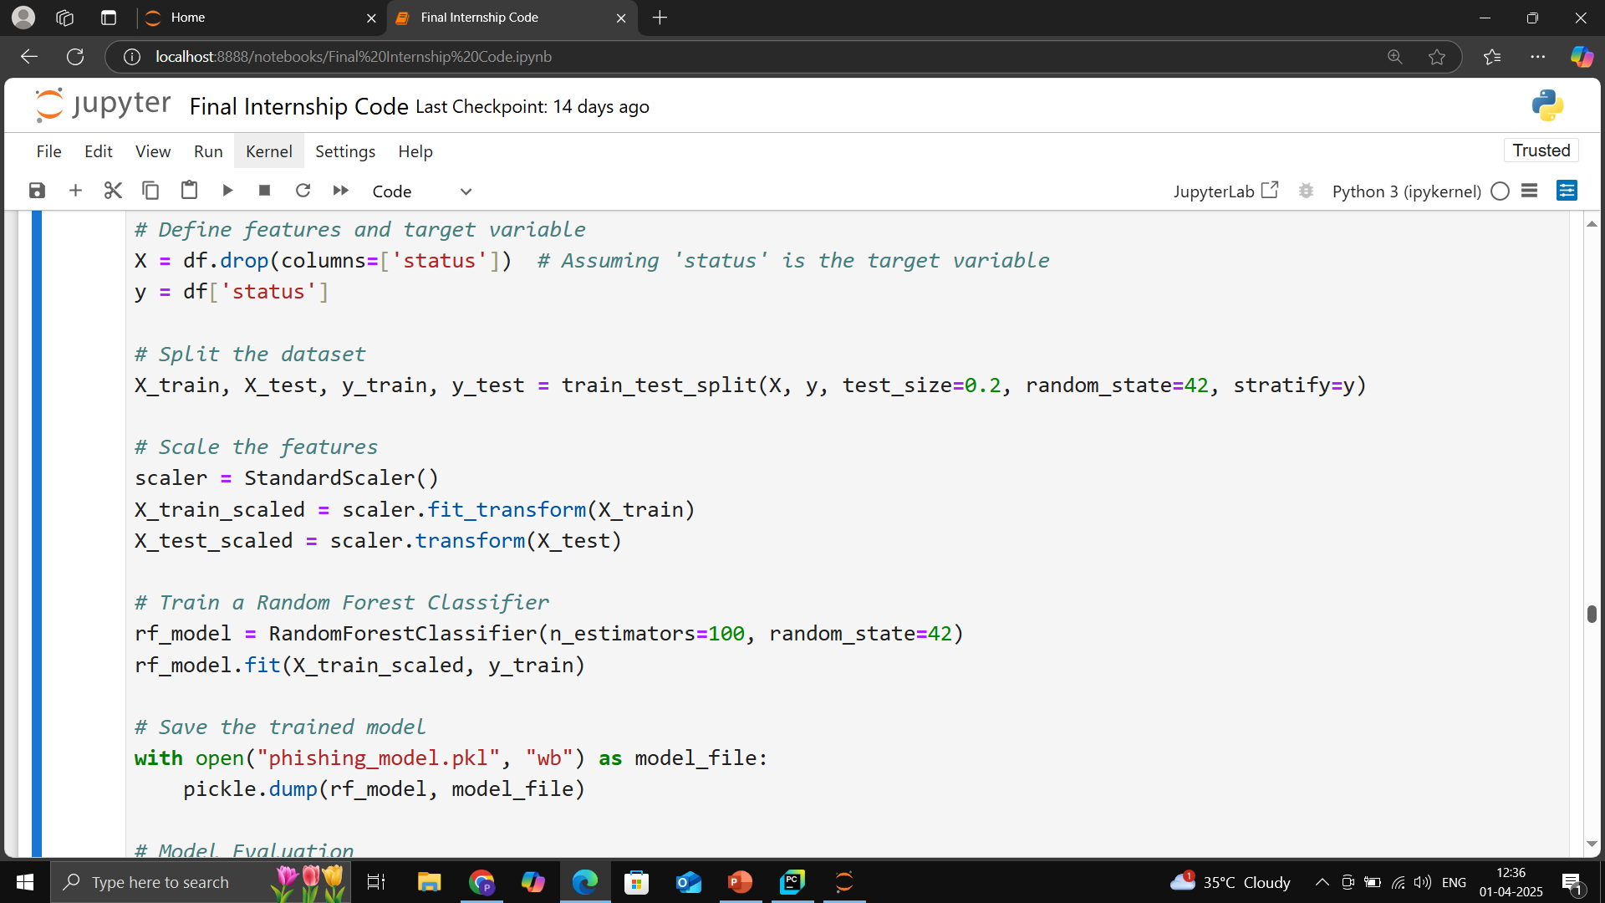

Slide 41
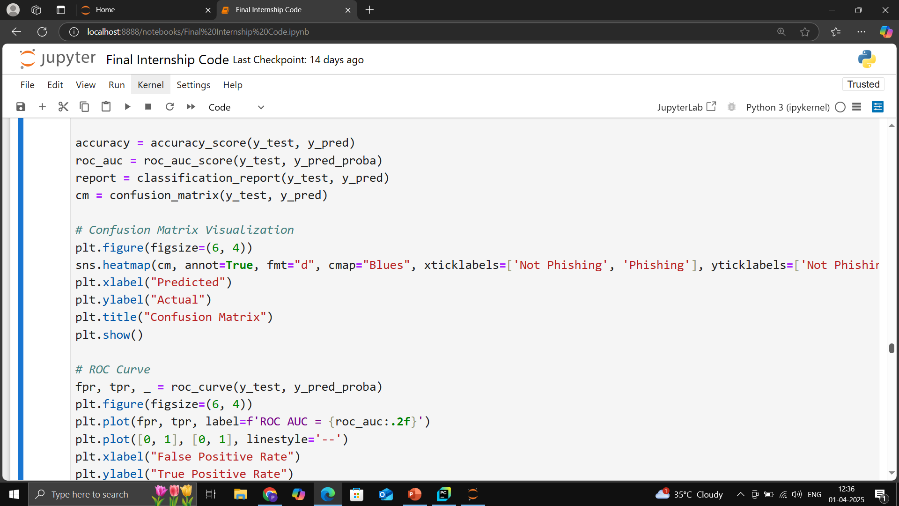

Slide 42
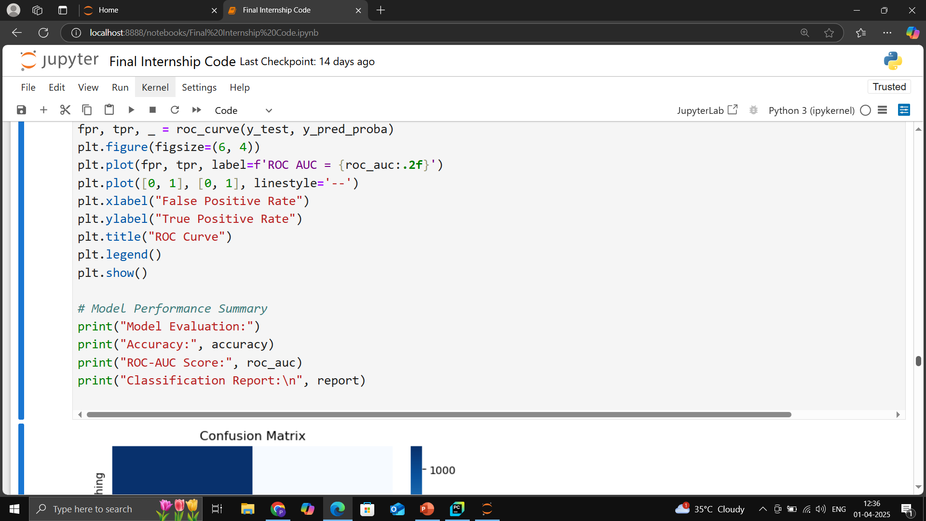

Slide 43
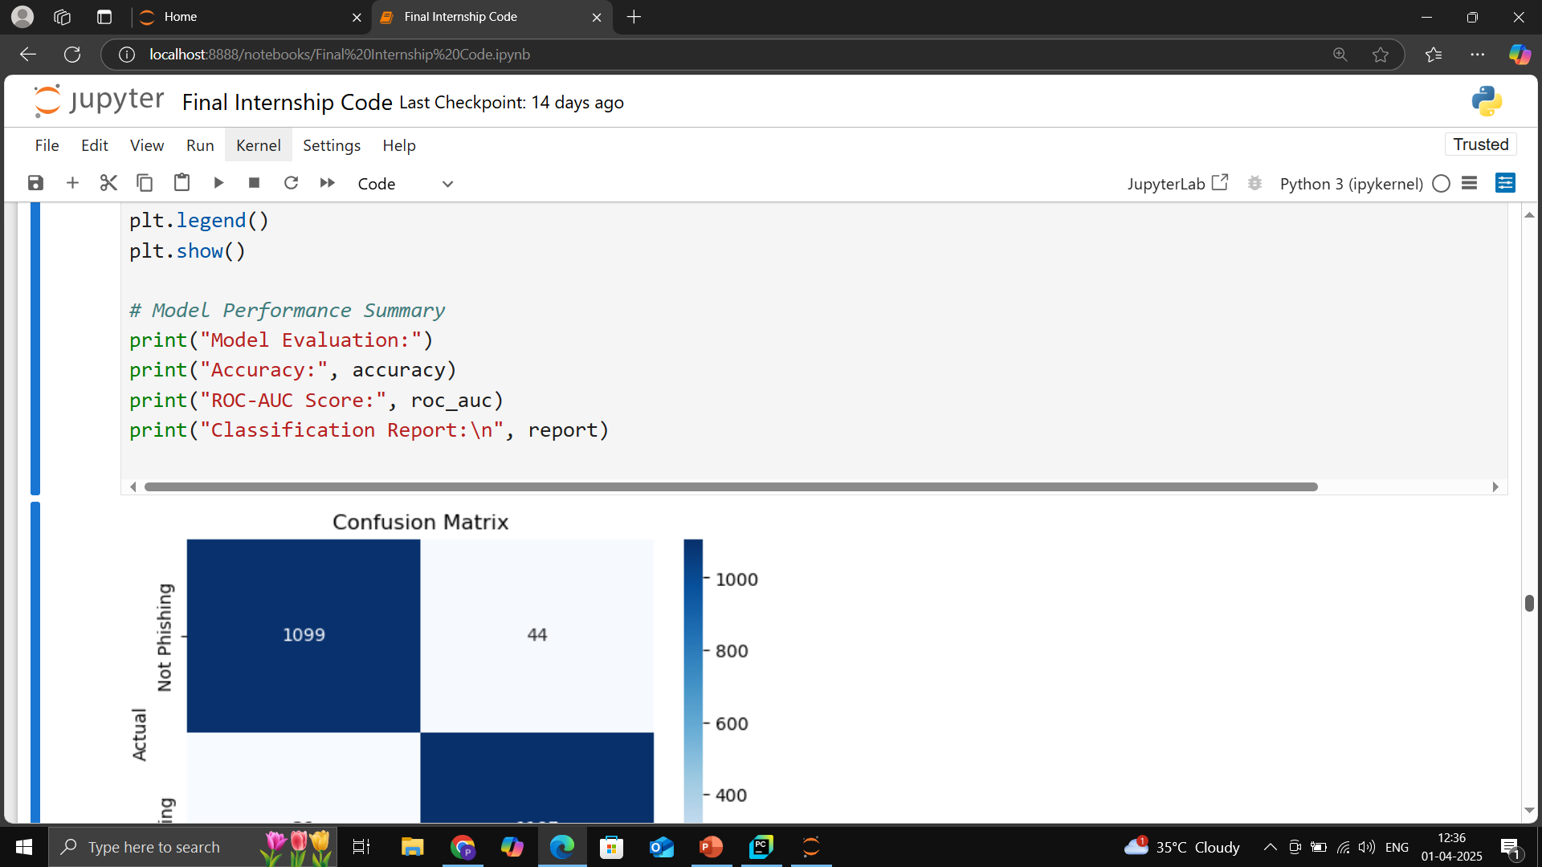

Slide 44
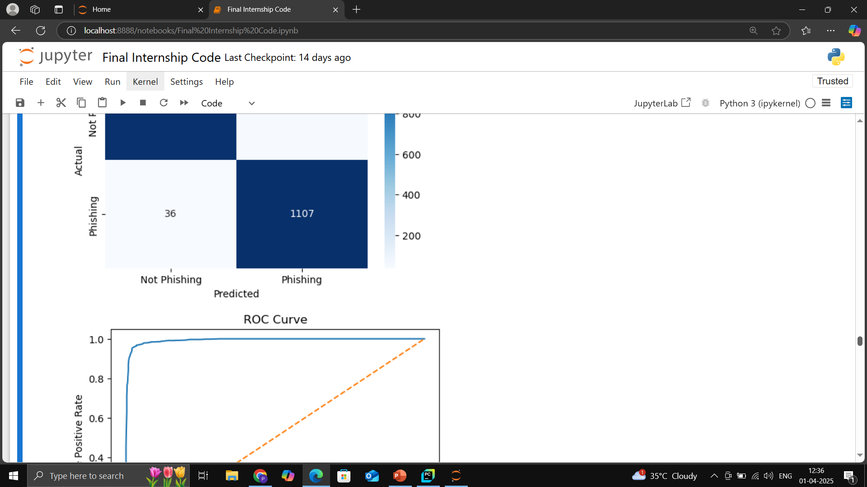

Slide 45
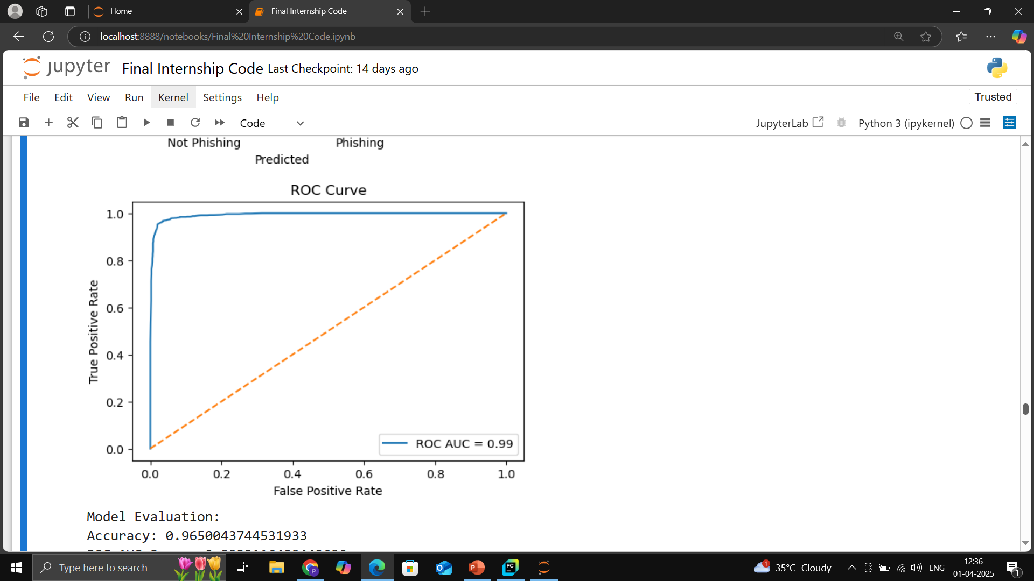

Slide 46
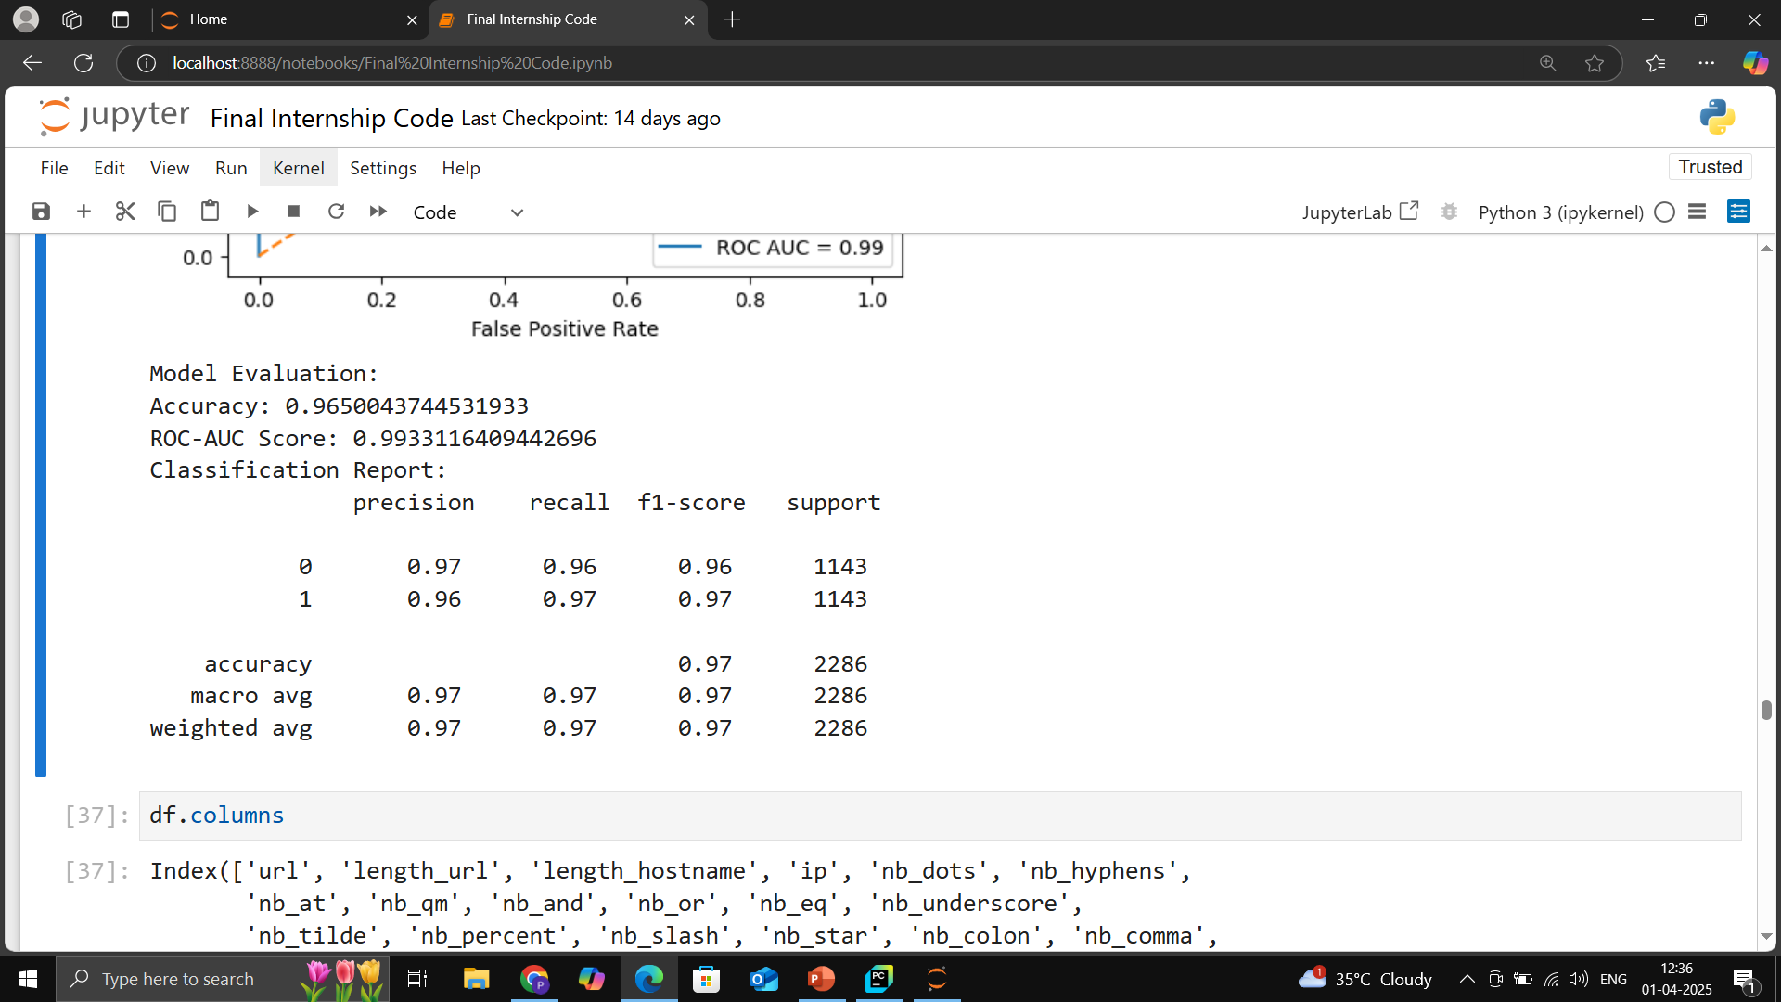

Slide 47
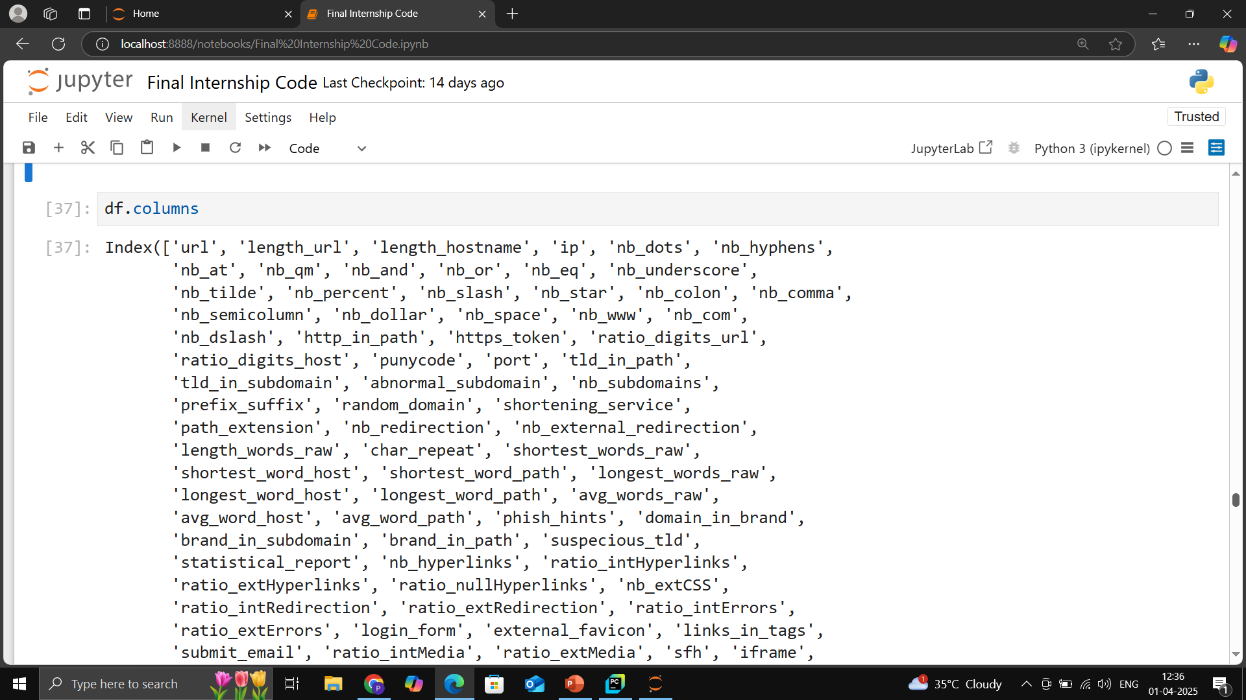

Slide 48
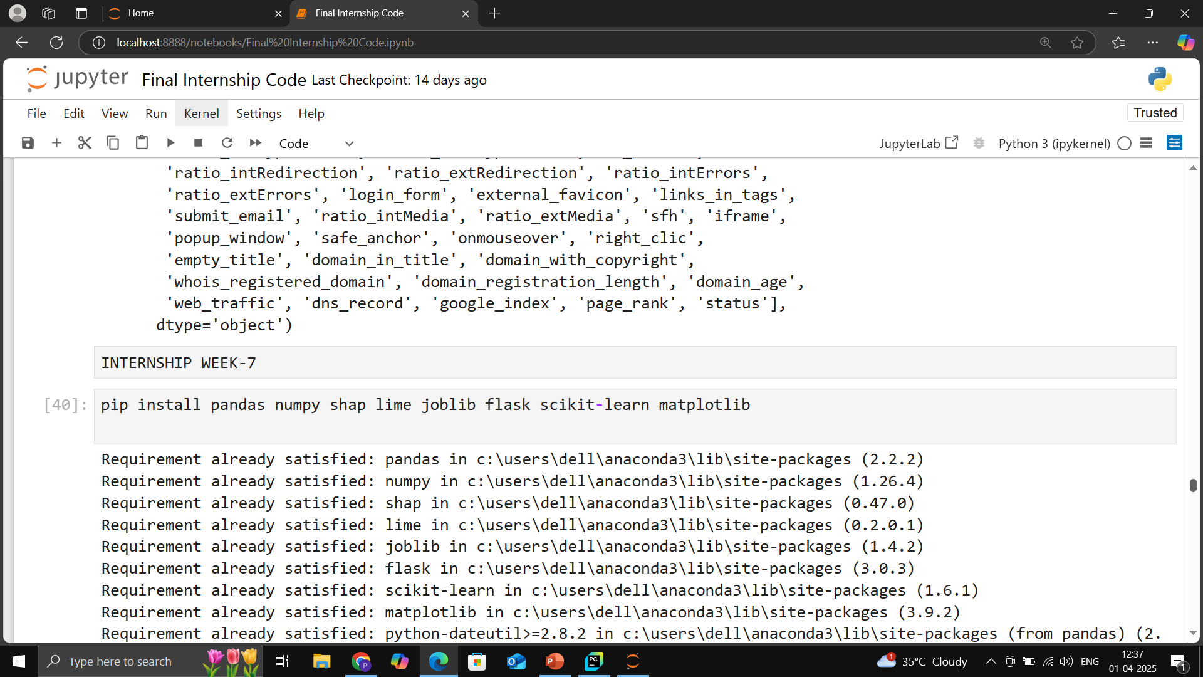

Slide 49
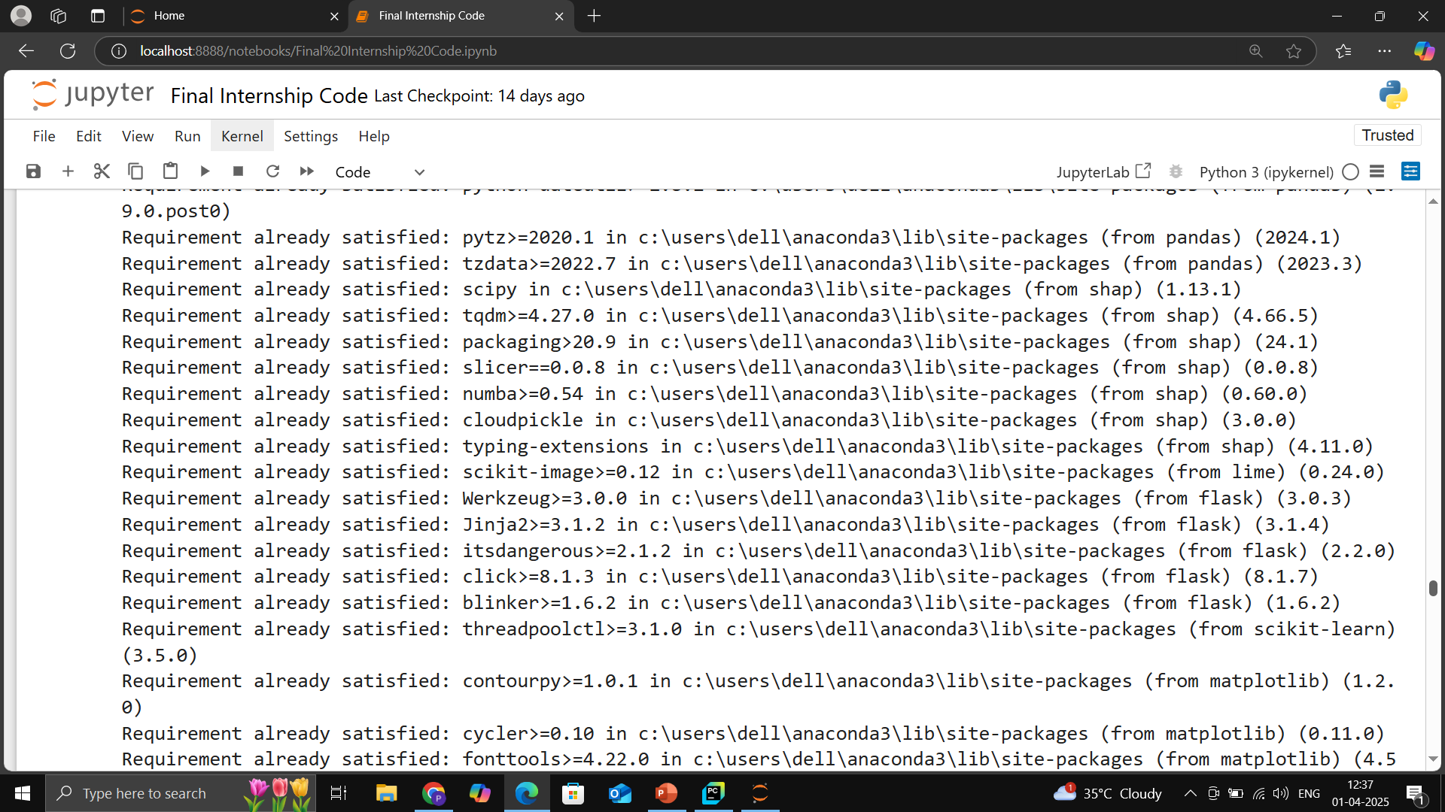

Slide 50
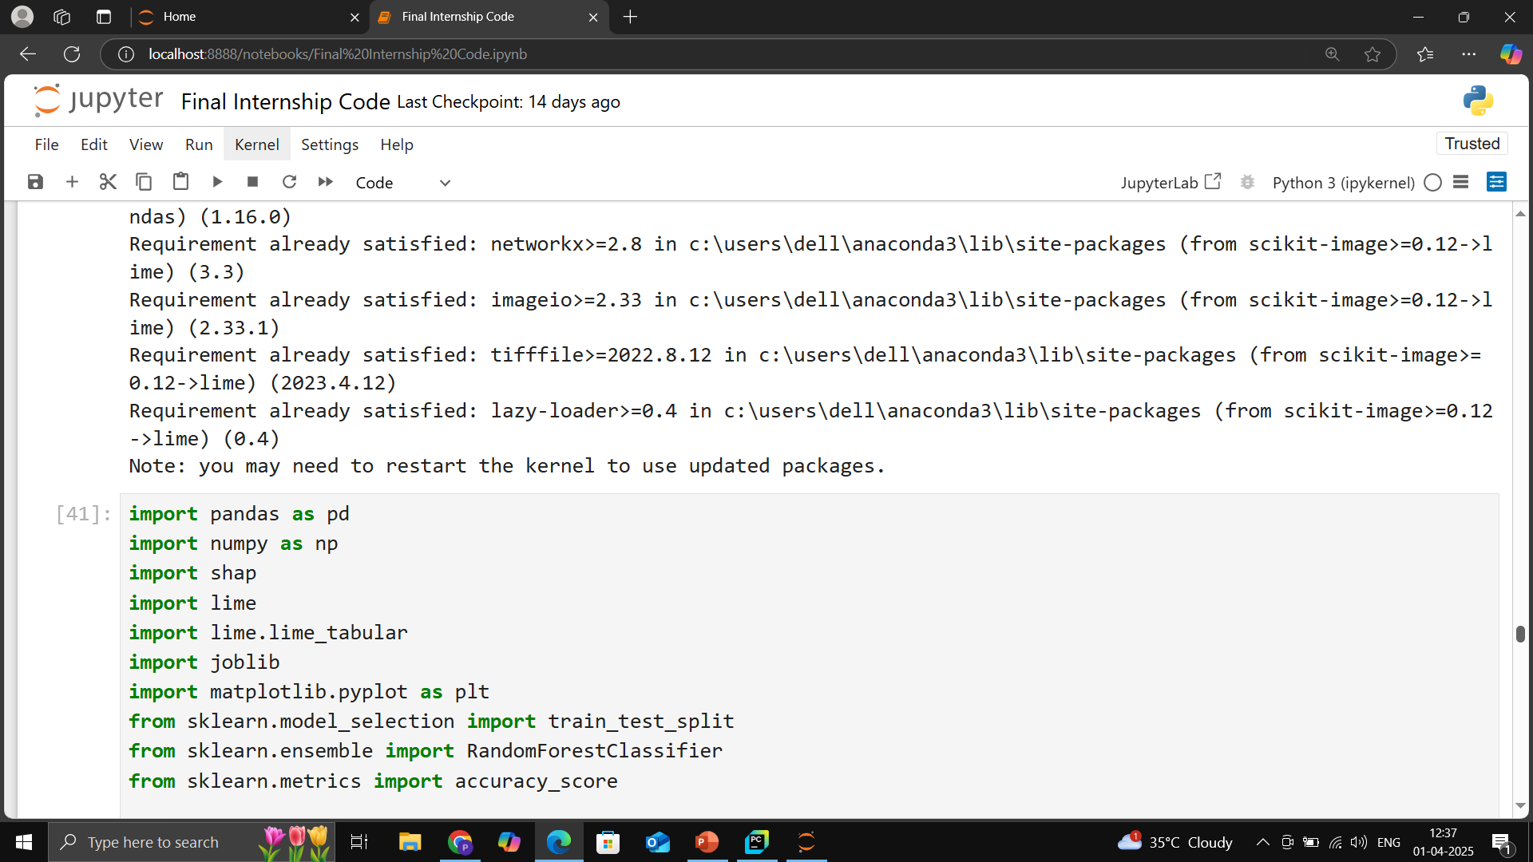

Slide 52
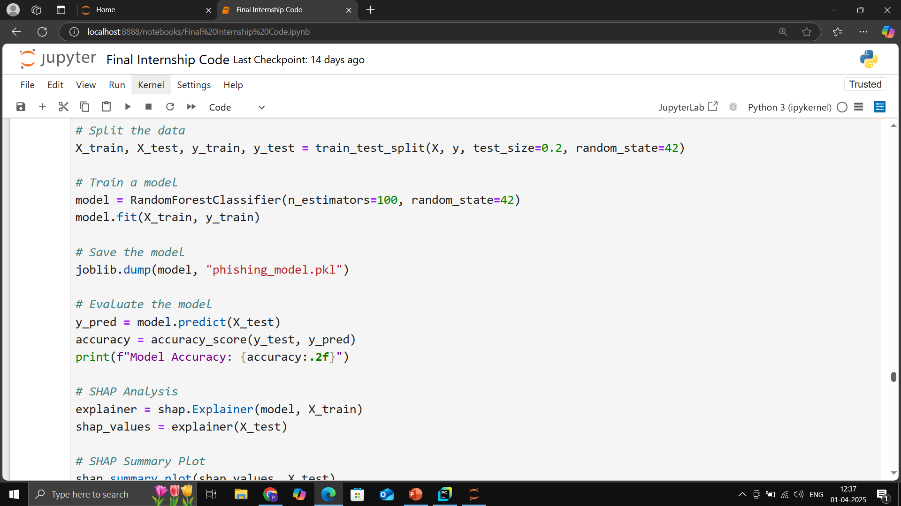

Slide 53
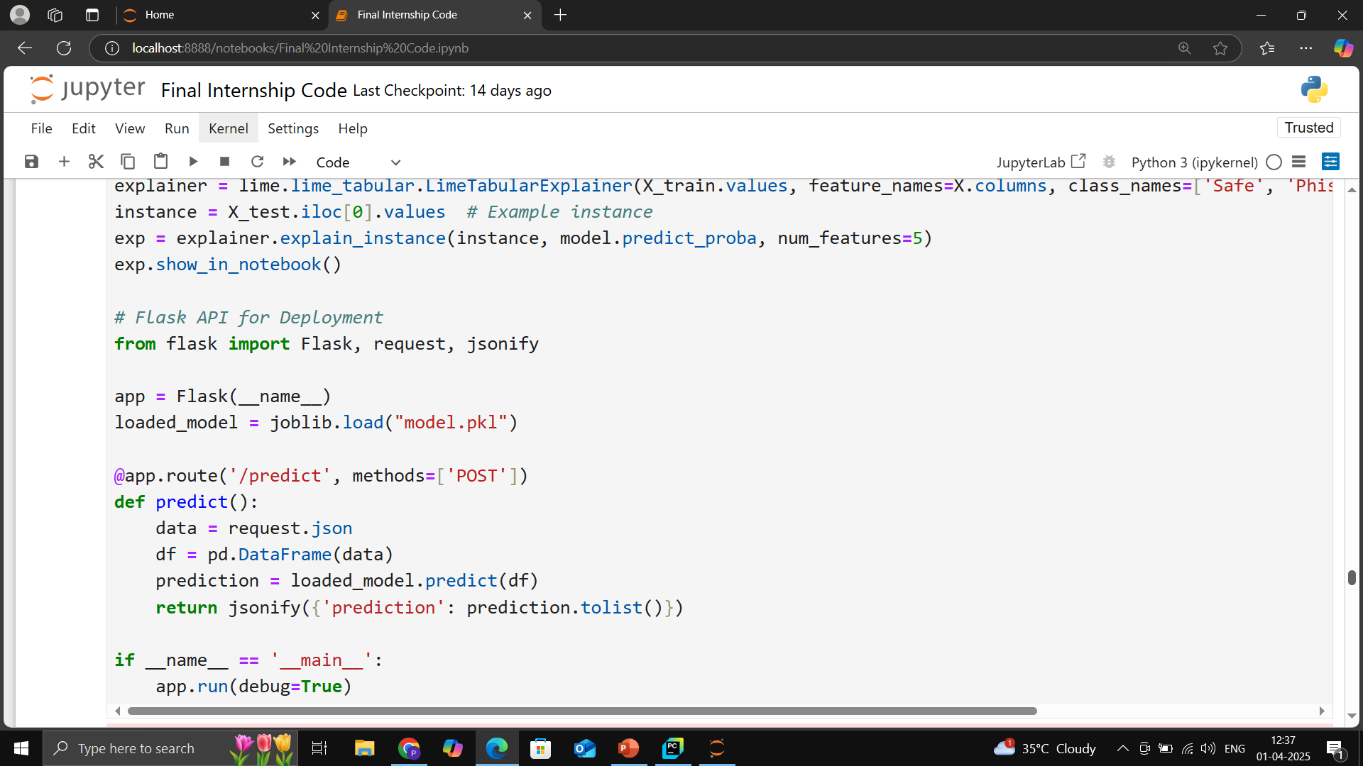

Slide 54
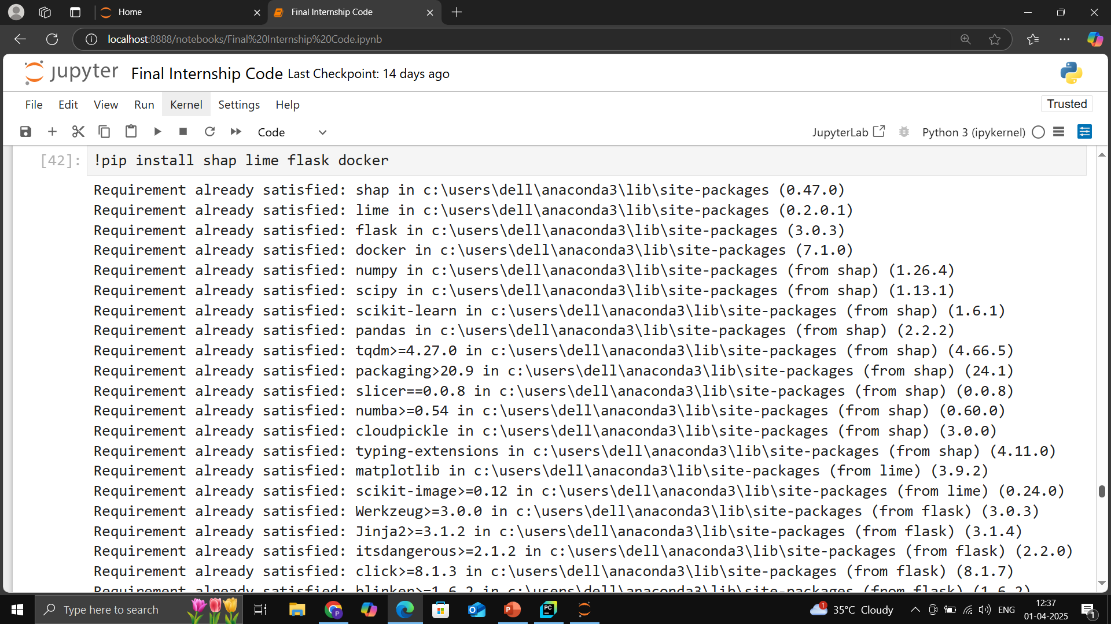

Slide 55
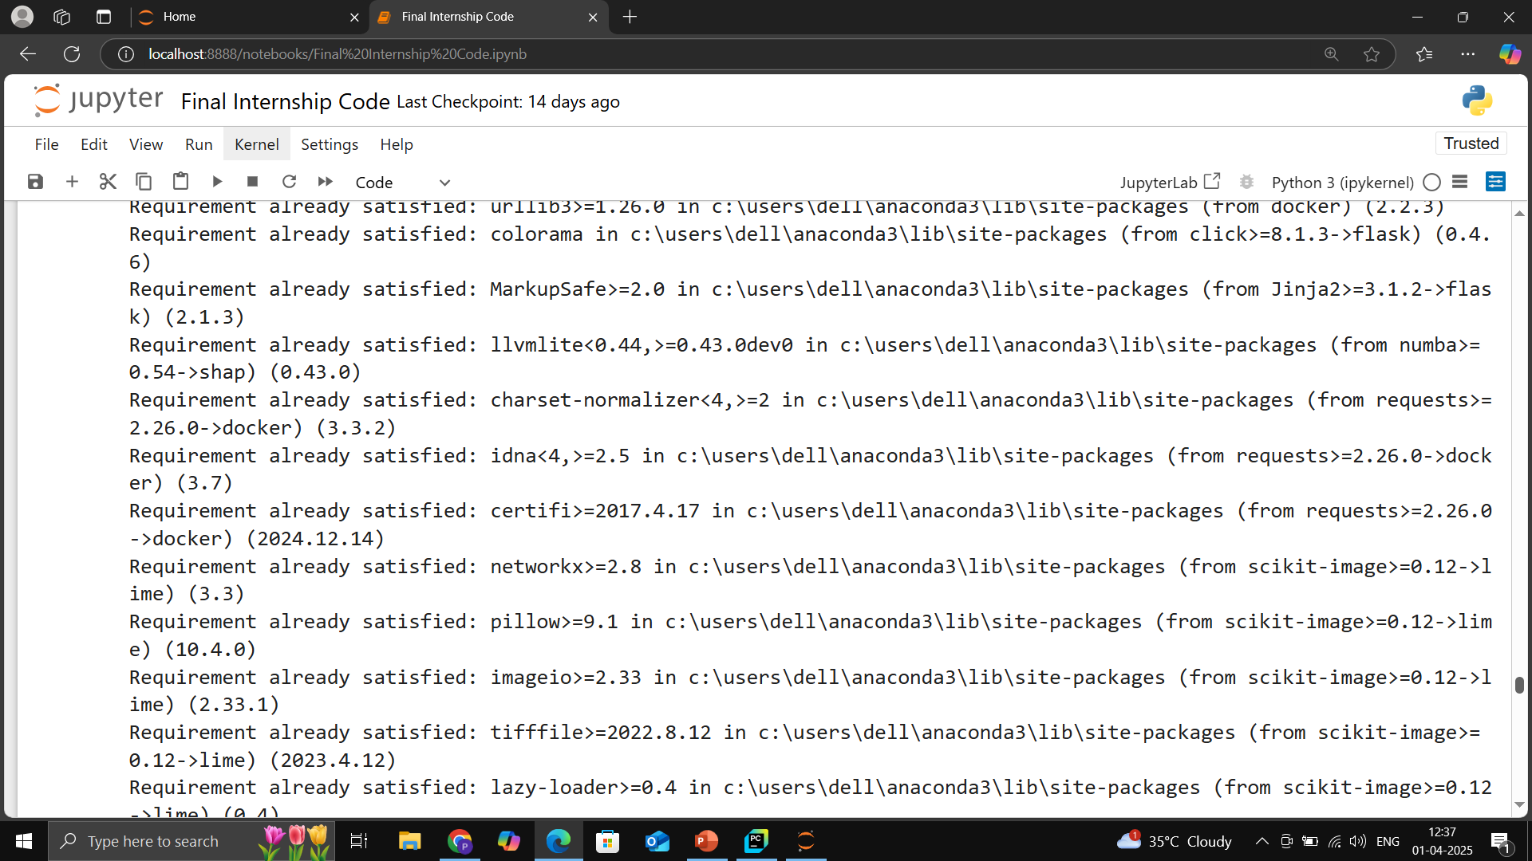

Slide 56
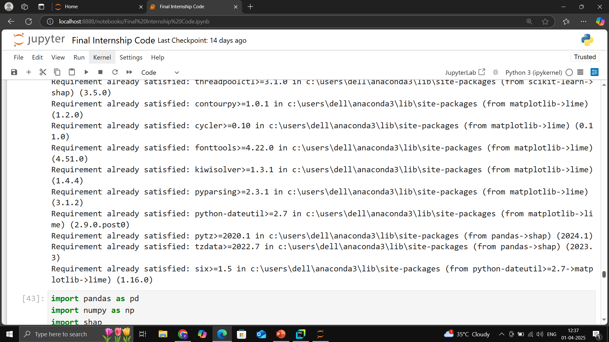

Slide 57
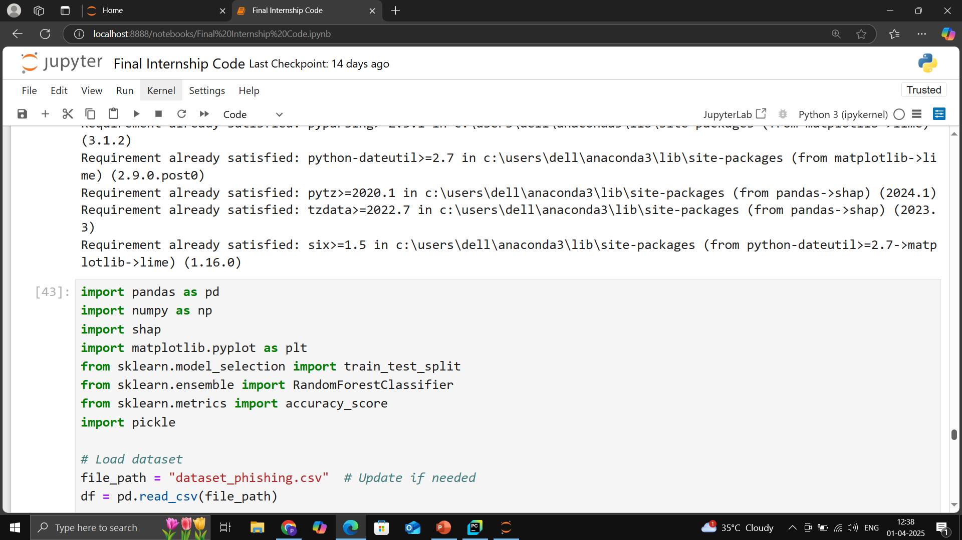

Slide 58
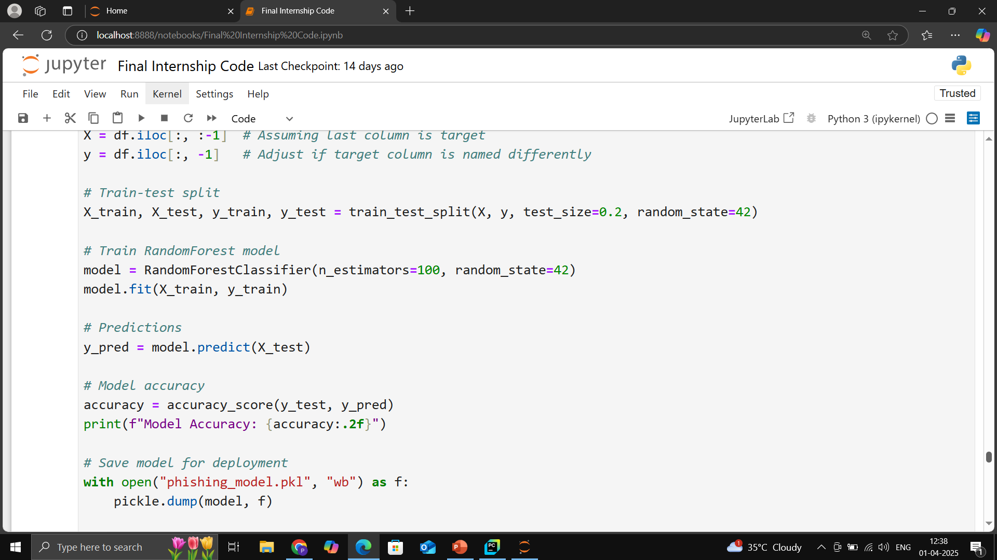

Slide 59
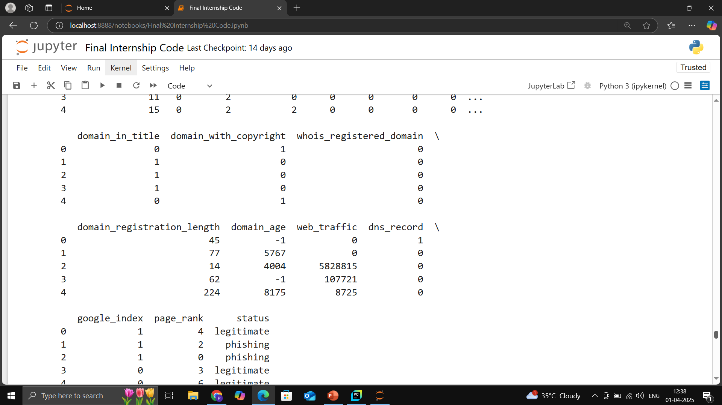

Slide 60
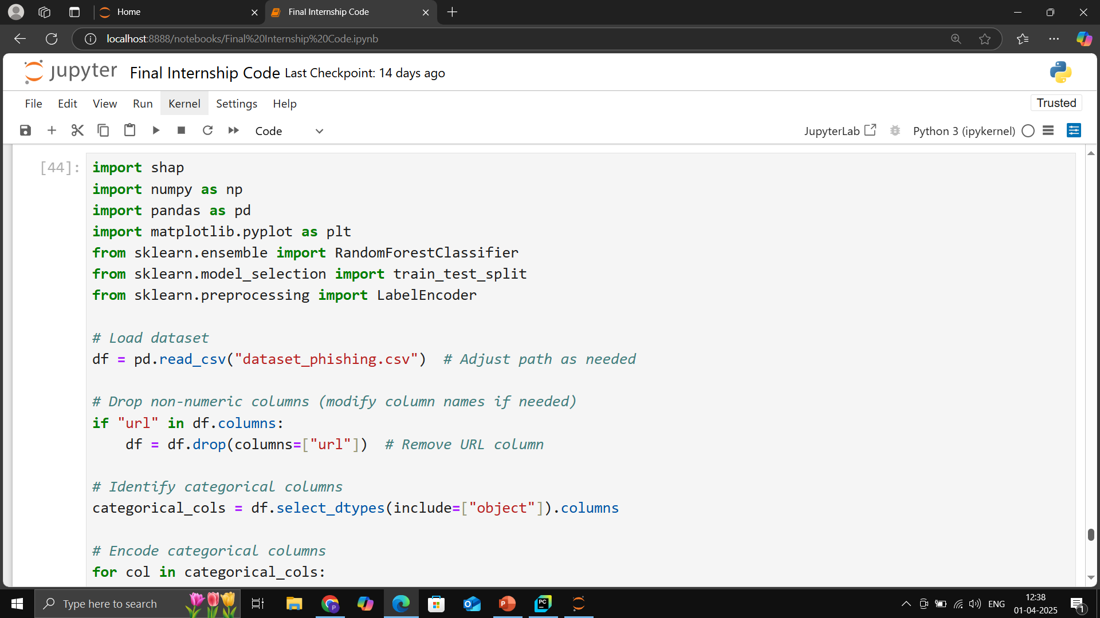

Slide 61
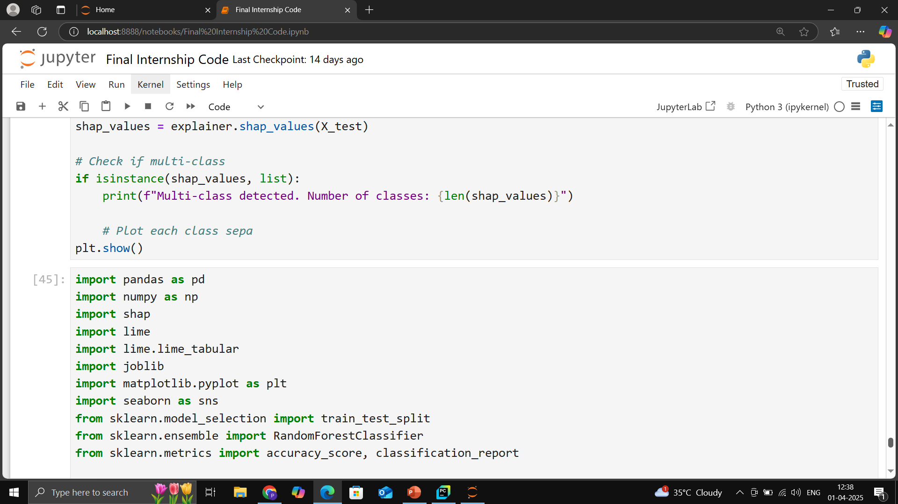

Slide 62
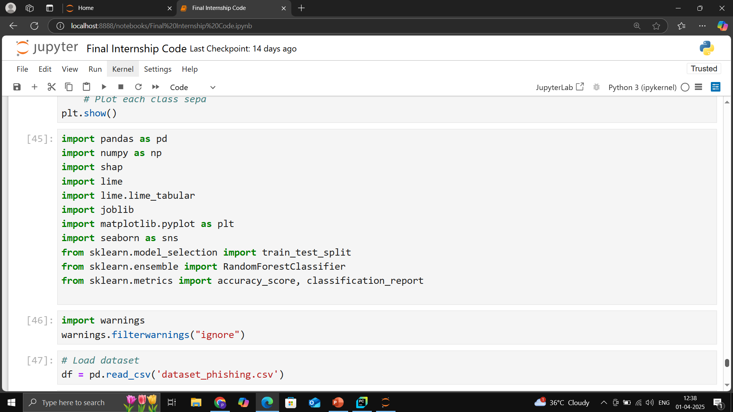

Slide 63
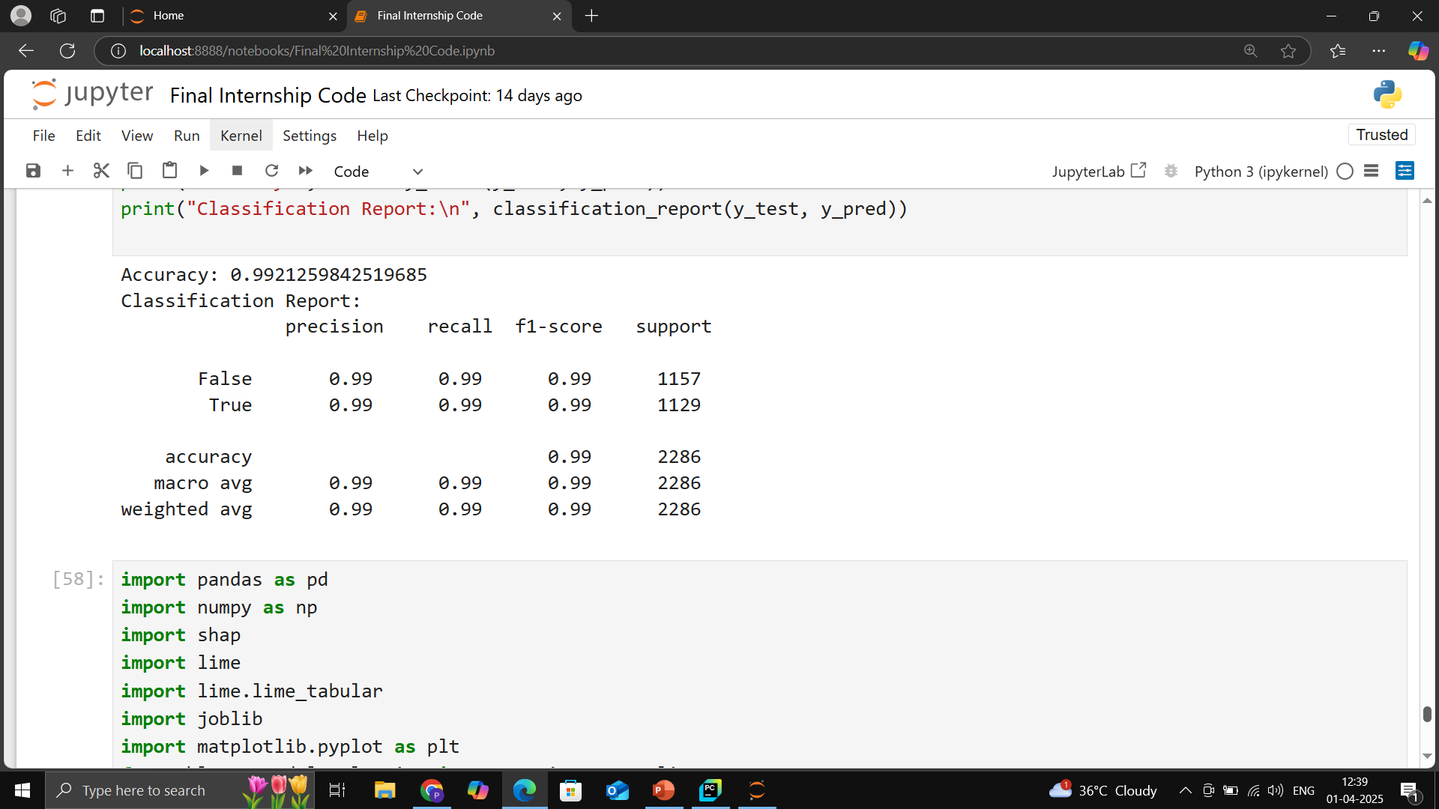

Slide 64
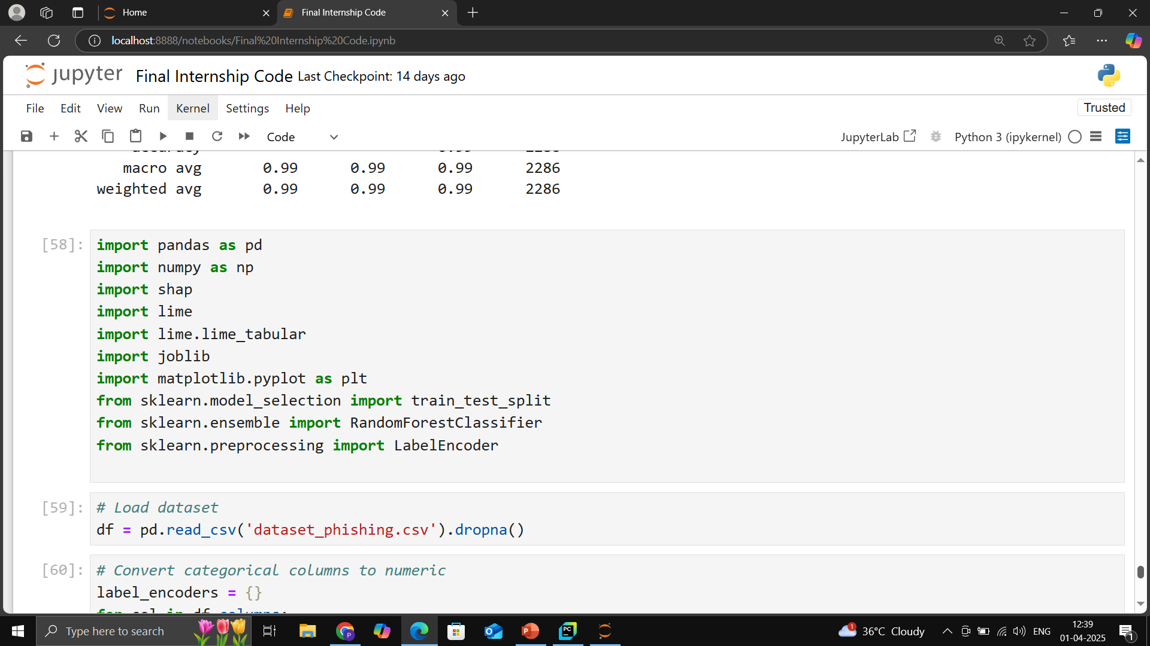

Slide 65
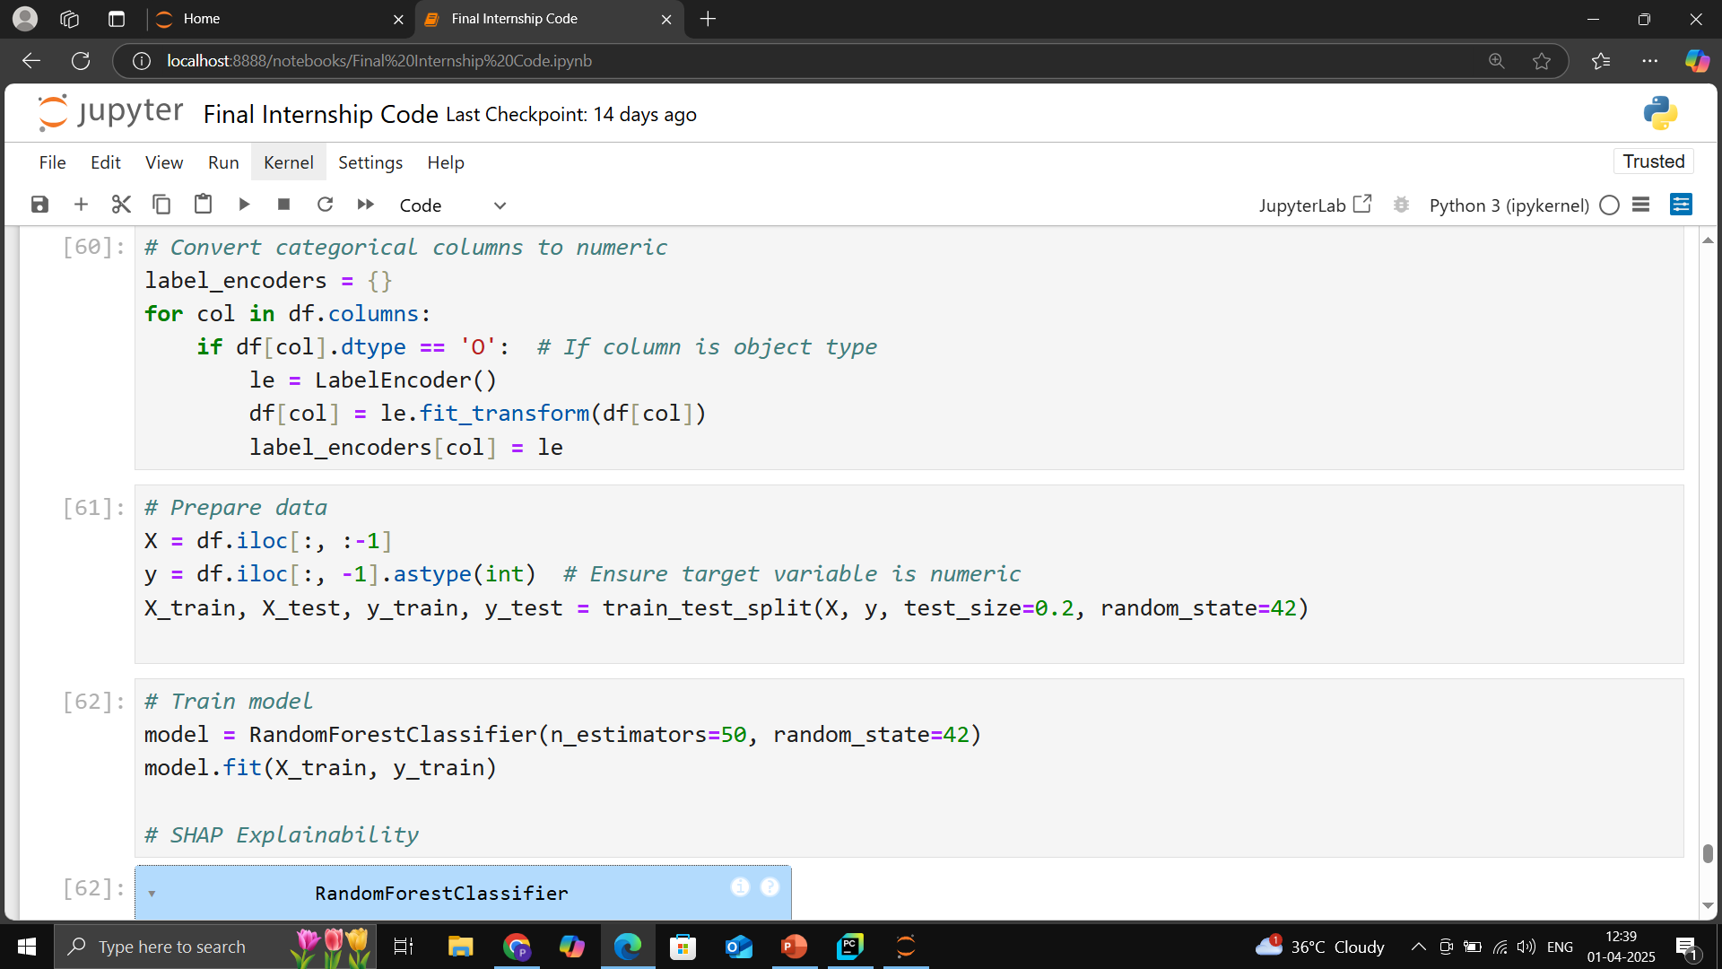

Slide 66
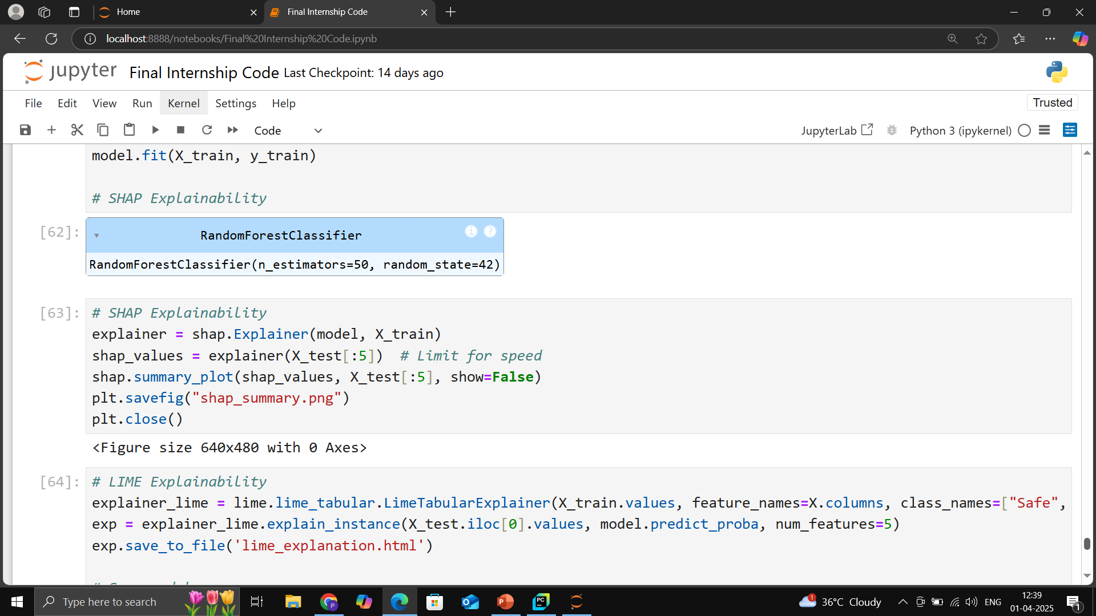

Slide 67
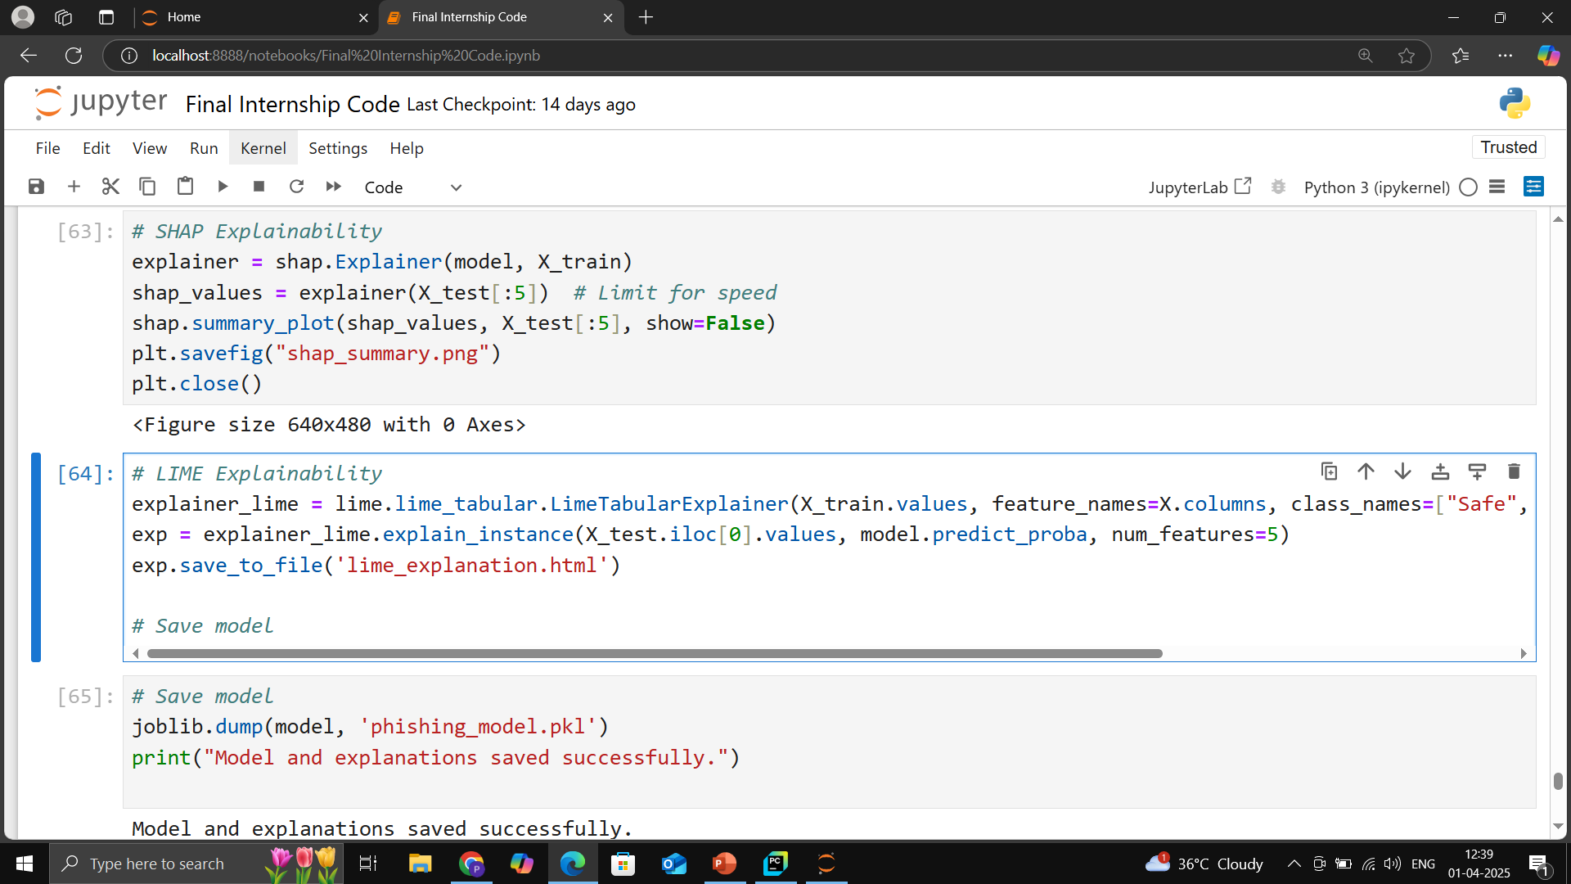

Slide 68
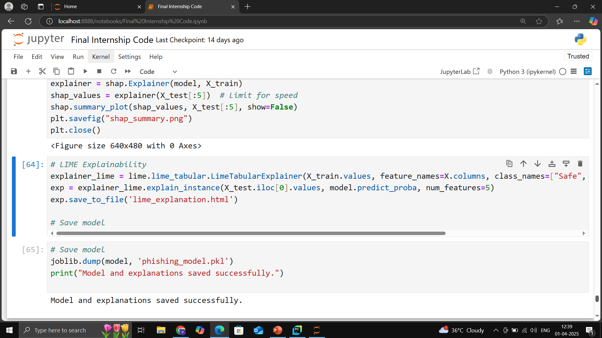

Slide 69

Model Deployment

Slide 70


Slide 71


Slide 72


Slide 73


Slide 74


Slide 75


Slide 76


Slide 77


Slide 78


Slide 79


Slide 80



Slide 81


Slide 82
Conclusion & Q&A
Final Thoughts.
Future Work & Improvements.
Questions & Discussion.

Slide 83
Final Thoughts
The project successfully developed a phishing detection model using machine learning techniques.
Feature extraction from URLs, domain details, and webpage content significantly improved detection accuracy.
The Random Forest and Neural Networks models provided the best classification results.
Phishing attacks evolve rapidly, requiring continuous updates to the detection system.
Integration with a browser extension or API can enhance real-world usability.

Slide 84
Future Work & Improvements
Real-time Detection: Implementing a system that continuously updates with new phishing threats.
NLP for Email Phishing: Expanding detection to phishing emails using Natural Language Processing.
Deep Learning Models: Using CNNs for analyzing webpage screenshots.
Blockchain for Security: Leveraging decentralized verification to prevent phishing scams.
Browser Extension: Creating a Chrome/Firefox extension for instant phishing alerts.
Mobile App Integration: Extending the detection model to mobile applications.

Slide 85
Questions & Discussion
How can real-time phishing detection be improved to adapt to new attack strategies?
What additional features could be included to enhance model accuracy?
How do modern attackers bypass current phishing detection techniques?
Could AI-driven adversarial attacks compromise phishing detection models?
What are the ethical and legal considerations in deploying phishing detection systems?

Slide 86


